Slide 1
Electricity as a Transportation Fuel:
What It Means for the Utility Business & State Policy
Becky Harsh
Director of Retail Consumer Policy
Edison Electric Institute

Slide 2
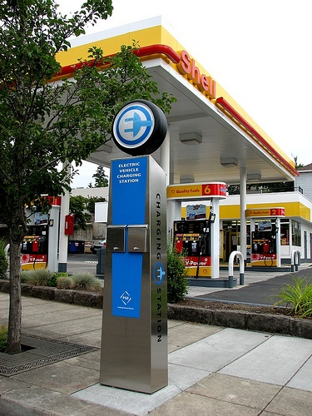
Electricity as a Transportation Fuel
Notes:
As utilities we’re very used to providing power for any number of things….TVs. computers, new appliances, air conditioning units, heat pumps and the like.
But I’m not sure that many of our companies were prepared to be the next “gas” station and yet here are.
This is a new issue for many of our companies…a bit of uncharted territory. BUT - We provide electricity to power any number of things, why not your car??
But it’s not just a new role to us – that of a transportation fuel provider - it’s new to our regulators and state legislators as well. Many are not quite sure how utilities do –or should – fit into this market. And they’re not the only ones…auto makers, battery manufacturers, car dealers aren’t quite sure of our role either.
So it’s a new world to a lot of us.
And we can’t ignore that many who were around 15-20 years ago when there was another push for this technology – they’re are wondering why is this time different…what’s changed?

Slide 3
What’s Different This Time?
International implications related to energy security.
Increased pressure to improve fuel economy and reduce carbon emissions.
Increased support and cooperation among stakeholders to make this a reality.
Improvements in technology.
Notes:
Actually a lot of things have changed…this is a different time, with different challenges, different priorities and different technologies. The opportunities for this transformational market are growing with amazing speed. And while still evolving there is no doubt that it is here to stay.
Today I thought I would provide you with a quick overview of the state of the market, explain why this is a good thing – both to society as a whole as well as our utility companies, and then talk some about what policy issues we’re seeing.

Slide 4
Already Here & Beyond the Road
Rail
Truck Stop
Forklifts
Seaports
Airports
Mining
Notes:
Electricity is already fueling any number of transportation applications – seaport loading docks, airport runways, in warehouses and manufacturing plants, mining – all are current examples of long established and widely available uses of electricity as a fuel.
And now with recent improvements in innovative automotive technologies – including advances in battery technologies, drive-trains, lightweight materials and computer systems – we have a whole new generation of light-duty passenger plug-in electric vehicles available as well.
And that market is growing at a tremendous rate.

Slide 5












Audi A3, R8 e-tron Launch 2014
BMW ActiveE trial begins 2012
BMW i3 Launch 2013
Chevrolet Volt Launch 2010
Audi A3, A4, Q7 e-tron PHEVs Launch 2014
BYD e6 Launch 2013
CODA Sedan Launch Early 2012
Nissan LEAF
Launch 2010
BYD F3DM Launch 2013
BMW i8 Launch 2014
Tesla Roadster Launch 2008
Ford Focus Electric Launch Early 2012
Chevrolet Spark Launch 2013
Cadillac ELR Launch 2014
Fisker Karma Launch 2011
Ford C-MAX Energi Launch Late 2012
Ford Fusion Energi Launch 2013
Mitsubishi Outlander PHEV Launch 2014
2012
2013
2014
Honda Fit EV Launch Late 2012
Scion iQ Launch 2013
Tesla Gen 3 Vehicles Launch 2014-2015
Mitsubishi I Launch Early 2012
Tesla Model X Launch 2013
Volkswagen E-Bugster Launch 2014
smart fortwo electric drive Launch 2012
Toyota FT-EV Launch 2013
Toyota RAV4 EV Launch 2013
Volkswagen E-Golf Launch 2014
Tesla Model S Launch Mid-2012
Volvo C30 Electric Launch 2013
Volvo V70 PHEV Launch 2014
Toyota Plug In Prius Launch Early 2012
Notes:
Here’s the latest information of who has or is planning to role out a PEV –be it all electric or a plug-in hybrid – it includes nearly every major auto maker. And the latest sales numbers are strong …
The number of PEVs sold in the first 6 months of 2012 is about as many as were sold in the entirety of 2011. Early estimates are that 2012 sales are expected to be roughly triple 2011’s numbers.
- Between Dec 2010 and Dec 2011, 17,000 PEVs were sold nationally.
Between January and June 2012, approximately 17,000 PEVS were sold.
The number of PEV models available has tripled since the roll-out of the first PEVs (Nissan Leaf and Chevrolet Volt) in late 2010, with more coming to market through the end of 2012 and 2013.
In 2011 there were only 3 PEV models available.
By the end of 2012, nearly a dozen PEV models will be commercially available. (Nissan, GM, -Toyota, Ford, Mitsubishi, Smart, Tesla, Honda, BMW, CODA, Fisker, Wheego)
An interesting statistic…the number of PEVs sold in the first 18 months of availability, oversold the number of hybrids sold during their first 24 months of availability.
Great news right??? But why do we care?? Why do utilities care? And why should any of you care?

Slide 6
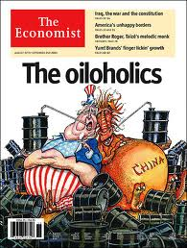

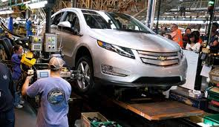
Why do we care?
  Enhanced Energy Security
  Economic Development
  A Cleaner Environment
Notes:
Well let’s start with the most obvious.
Of course, utilities, as well as others, recognize the significant societal benefits of electrifying the transportation sector:
It provides energy security
It provides economic development opportunities
Cleans up the Environment

Slide 7
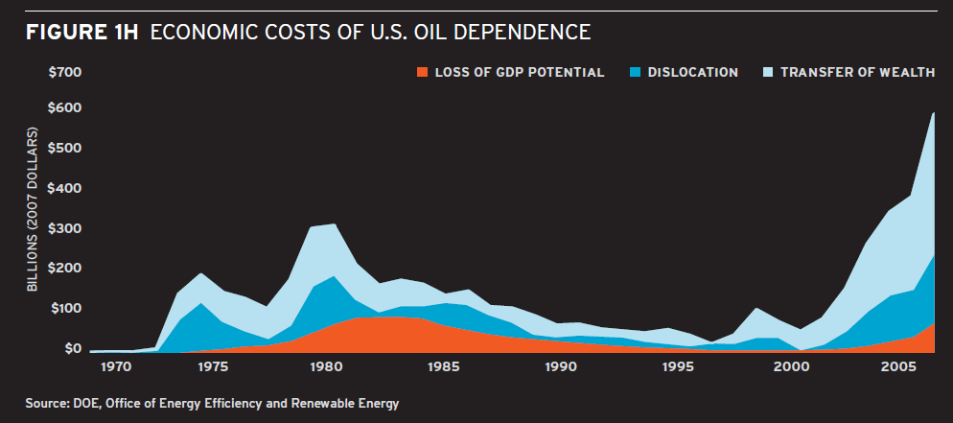
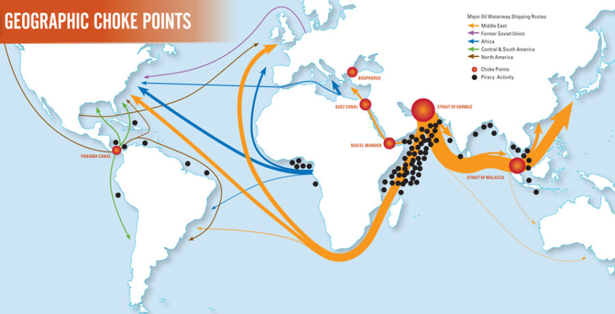
Energy Security
The U.S. imports 50% of its oil often from unfriendly or unstable countries
The U.S. economy and in particular the transportation sector are heavily reliant on oil
The costs to the economy and to the nation’s security can be measured in the $100s of billions annually
Notes:
Energy Security
Oil consumption in the US currently far exceeds anything it can produce domestically, forcing it to have to rely on foreign imports, many of which come from unstable or unfriendly countries…raising significant energy security issues.
With 70% of that oil being utilized by the transportation sector, it’s critical that alternative fuel vehicles become a bigger part of the mix as a way to reduce our dependence on foreign oil.

Slide 8
Economic Development
Reducing the nation’s trade deficit and utilizing domestic energy resources will inject billions of dollars into the economy that would otherwise be going overseas
Furthermore, PEV and battery manufacturing and related technological innovation are already creating a vibrant, new economic sector, with thousands of high-quality jobs
  Since 2007, over 30 battery, drivetrain, and component manufacturing facilities have opened across the country due to matching public-private funds
  Over a dozen assembly plants have opened or been re-tooled to build PEVs
Notes:
Economic development and job creation…
By investing money and resources into domestically produced transportation fuels like electricity, we could effectively inject billions of dollars back into our economy instead of sending it overseas.
It also has the potential to open the door for a variety of new economic opportunities and not just in the vehicle market – there is potential in both the on and off road markets.
New Vehicle Production
New technology - Diesel fuel conversion applications – electric forklifts or conveyor belts
Battery and Component Manufacturing
Charging stations and additional infrastructure
All create the opportunity for create high-quality jobs throughout the country.

Slide 9
A Cleaner Environment
The extraction, refinement, production, and transportation of petroleum is harmful to the environment—and it will never become cleaner
However, over the last decades, electricity generation has gotten progressively more diverse & cleaner, and it will continue to do so
PEVs produce fewer or no tailpipe emissions
In a few decades, widespread adoption of PEVs could reduce GHG emissions by 450 million metric tons annually
Notes:
Cleaning up the Enviornment - with the increasing pressure to reduce emissions and green house gases– electrifying the transportation sector makes a lot of sense.
The lack of (or greatly reduced) tail pipe emissions speaks for itself.
The impacts of gasoline emissions that are well established and chances are it will never be any cleaner.
Electricity generation on the other hand has gotten progressively cleaner over the last decades, largely due to better technology at the generation plant but also from a diverse and cleaner portfolio of fuels – including natural gas, hydro, and renewables.

Slide 10
Utility Benefits
Only Remaining Opportunity for Sustainable Load Growth
Operational Benefits & Downward Pressure on Rates
Customer Engagement & Satisfaction
Gateway for Utilities OR New Market Entrants to Offer Energy Products & Services
Notes:
But beyond all the societal good there are some solid utility benefits as well.
Transportation is the only remaining sector left to electrify – providing perhaps the only remaining opportunity for sustainable load growth !
It can provide operational and system benefits:
Properly managing new ET load can increase off-peak asset utilization, potentially putting downward pressure on the rates of all customers. Using things like:
EV Rates – or rate structures that encourage off-peak charging
Smart Charging - vehicles and charging stations set up with timers to begin charging at off-peak times
Education – providing customers with information
Distribution Upgrades – ensuring that neighborhood transformers are updated
In the VERY near future, PEVs may be a significant DR resource
It provides a way to build new customer relationships, improve customer satisfaction, and develop new renewable and energy efficiency strategies.
It’s also a gateway technology for utilities (or new market entrants) to provide new energy products and services – home energy management applications, storage,

Slide 11
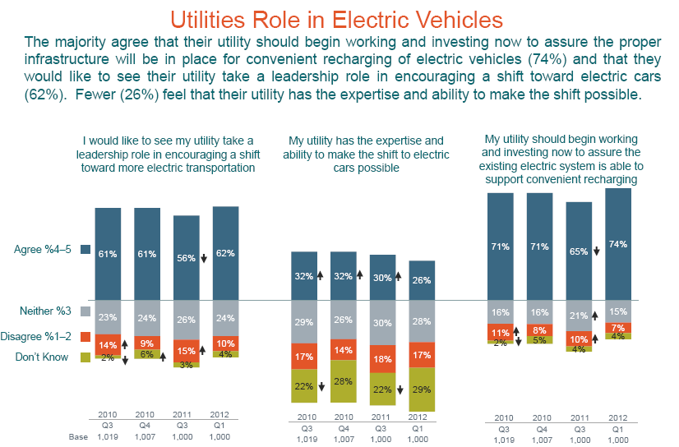
Customers
Notes:
Here’s an example of some data pulled from EEI’s recent power poll survey.
The majority of customers (74%) agree that utilities should be working and investing now to ensure that there is adequate and convenient charging infrastructure in place.
62% would like to see utilites taking a leadership role to encourage the shift towards helping to put more electric cars on the roads.
However, only 26% felt their utility had the expertise and ability to make that shift possible.

Slide 12
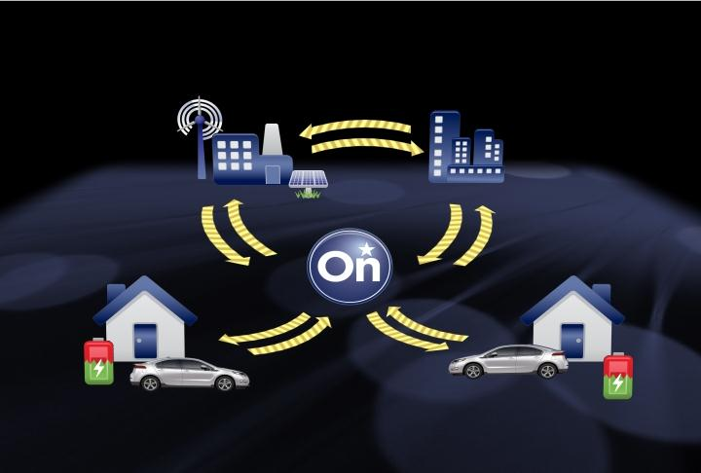
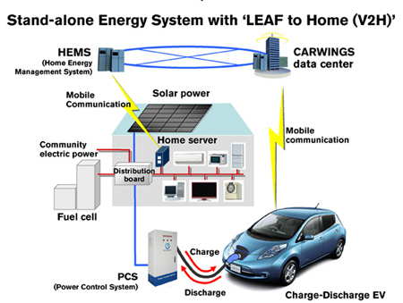
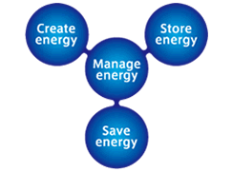
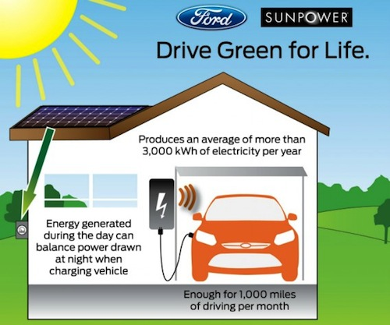
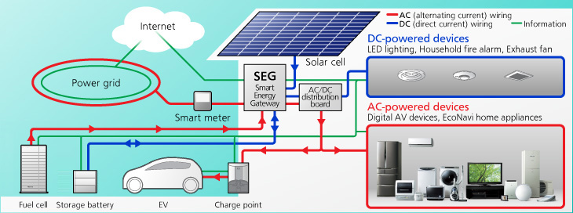
New Market Entrants & Competition
Notes:
Also, as I mentioned vehicles can provide utilities with a range of new touchpoints with their customers. It can provide a gateway to other opportunities for customer engagement. But that’s not limited to just utilities
Other companies are already seeing potential in this area and are already moving forward - and around - the utility to do it.
Here’s a few examples of who’s already out there…using electric vehicles as a new way to engage customers on energy management issues.
OnStar – is looking at the energy management business model.
Ford is partnering with SunPower to provide solar solutions to generate power during the day to off-set the vehicle charge at night.

Slide 13
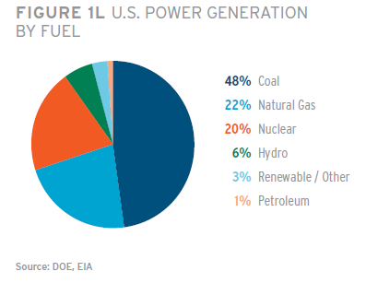
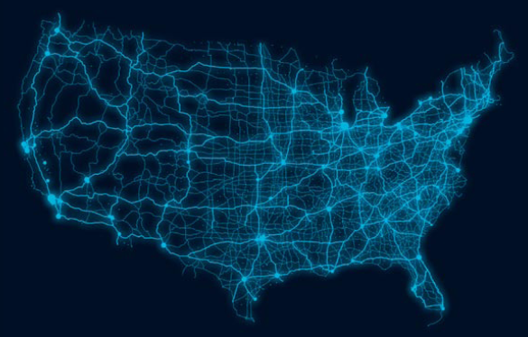
Electricity: Plug Into Its Potential
Costs $1 per gallon!
Domestically produced
Multiple supply sources
Existing delivery system
Notes:
Beyond the direct benefits to the utility - the value message of electricity as a fuel is good one!
The cost of electricity to fuel a vehicle is the equivalent of $1 per gallon of gasoline. Even when gas prices seem to be declining at the moment – this is a significant savings.
It’s domestically produced – supporting energy independence.
There is an abundant and diverse supply available.
And most importantly, the delivery system already exisits – it’s as close as you nearest room outlet.

Slide 14

Forecast
Hurricanes Ike & Gustav
Middle East Revolutions & Civil Wars
Iran-Iraq war starts
‘81-’82 Recession starts
Hurricane Rita
Hurricane Katrina
‘80 Recession
Iraq invades Kuwait, 1990 Oil shock
Crude Oil Price Collapse
US Invades Iraq
???
Iran Threatens Strait of Hormuz
‘01 Recession
Asian Financial Crisis
Iranian Revolution, 1979 Energy Crisis
‘07-’09 Financial
Crisis starts
*Based on a plug-in electric vehicle with an efficiency of 3.4 miles per kWh and an internal combustion engine vehicle with a 30mpg rating.
Source: Energy Information Administration, Short-Term Energy Outlook, June 2012. Data compiled, converted, and presented by the Edison Electric Institute.
Notes:
I wanted to share with you a graph we use often that shows the volatile nature and unpredictablity of the price of gasoline v. the cost of electricity. You’ll notice that no matter the crisis de jour the price remains relatively stable.

Slide 15
State Policy Matters
Many Legislatures are moving quickly and aggressively on policy that can impact our business
Nothing happening at the Congressional level
In most cases, Regulators are not moving as quickly as legislators—need to have both groups acting complementarily
Notes:
So we’ve talked about he societal good, the utility benefits, and the overall value of electricity as a fuel message, but why should you in this room care?
Because many state legislatures are moving quickly on issues involving electric transportation, many of which have a direct impact on our business.
There is nothing happening at the federal level and no hope of anything, anytime soon.
Regulators are slow to act on these issues. They just aren’t connecting with the issue the way legislatures are at this point. But we need both legislatures and PSCs working in the same direction.

Slide 16
Top State Legislative Issues
Status of Electric Vehicle Service Providers (EVSPs)
  Regulated as utilities or not?
  Considered electric resellers or not?
Role of Utilities
  Permitted to explore charging business models or not?
  Sole Provider of electricity status protected?
Road Taxes
Early Notification efforts (Access to DMV Records, etc.)
State Collaborations & Advisory Councils
Notes:
At the legislative level the top issues we’re seeing largely fall into these categories:
Defining the status of 3rd party service providers…should they be regulated the same as utilities for providing electricity to customers? Are they considered re-salers?
Another area is defining the role of the utility in the charging business. Should utilities be permitted to be in the charging station business – owning and operating charging equipment in the private sector?
Road tax – how should this issue be addressed given that currently it is included in the cost of gasoline? Should the utility be responsible for reporting and collecting that tax on the utillity bill?
Early Notification – should utilities be given access to who has bought these vehicles to better plan any necessary distribution upgrades? As utilities determine what transmission and distribution upgrades might be needed
Development of State Collaboration and Advisory Councils – putting groups of stakeholders together earlier in the process to talk about planning and preparation – includes state government staff, utilities, other stakeholders

Slide 17
2012 State Legislative Examples
Maryland
  HB 1279 / SB 998: Passed – Allows the Motor Vehicle Administration to provide electric utilities with address information of PEV registrations
  HB1280 / SB 997: Passed – Exempts EVSE providers from falling under definition of electricity supplier or public service company
Colorado
  HB 1258: Passed – EVSPs are NOT regulated as public utilities; are considered to be “electric resellers”
Kansas
  HB 2455: Failed – Created electricity road tax, potentially to be collected by utilities; EVSPs are NOT regulated as public utilities; Required the installation of a separate meter at all EVSE locations
Notes:
Here are a couple examples of recent bills that have passed…
In Maryland, they passed a bill that provided utilities with access to DMV records to assist in their infrastructure planning efforts – to give them a better idea of where the cars were coming, to what neighborhoods, etc.
They also passed language that exempted Electric Vehicle Service Providers from the definition of an electricity supplier. We’re seeing this to be the trend among states and commissions considering this issue and even in proposed federal legislation (excluding 3rd party from PURPA standards).
Most states that have taken this up are agreeing that 3rd parties should not be regulated like an utility. That they are charging for a service, the cost of the electricity is part of that service and that it doesn’t equate to the sale of kilowatts.
Colorado – another example of recent legislation passed that exempted 3rd parties from regulation as a public utility and they were considered to be an “electric resellers”
Kansas – very interesting case on the road tax issue – there was a push for the creatiion of an electricity road tax, likley to be collected by utilities; also it required the a separate meter be installed at ALL EVSE locations – talked with KCPL and got them engaged and were able to kill that bill.

Slide 18
Top State Regulatory Issues
Status of Electric Vehicle Service Providers (EVSPs)
  Regulated as utilities or not?
  Considered electric resellers or not?
Role of Utilities
  Permitted to explore charging business models or not?
  Education or other responsibilities
  Sole Provider of electricity status protected?
Cost Recovery
Rates (max benefits to customers, min costs to utility)
Metering (sub-metering, costs)
Early Notification
Notes:
As I mentioned we aren’t seeing nearly the activity level from the regulatory community. Mostly we’re seeing activity in the first launch states like CA, OR, WA, MI and a few others are the exceptions, but many regulators are still hesitant to fully engage on this topic.
For those that are there are similarities with some of the legislative issues.
Defining the role of 3rd parties as regulated utilities…
Defining the role of utilities in the charging business…
But we’re also seeing issues come up about what the utility’s responsibility in providing customer education on this issue? Is the utility’s role as the sole provider of electricity to 3rd parties protected (also came up in CO bill)
Cost recovery for infrastructure upgrades (local distribution level)
Rate issues,
Sub-metering (2nd meter for charging station)
Early notification

Slide 19
State Regulatory 2010-2012 Examples
Oregon PUC Order 12013 – Jan 2012
  Highlights: EVSPs NOT utilities; utilities NOT precluded from charging business; utilities required to file whole-house-TOU and EV-specific TOU rates; encourage utilities to provide education; line extension policy extends to EVs
California Phase 1 Decision – July 2010: EVSPs are NOT considered utilities
California Phase 2 Rulemaking – Ongoing
  Sub-metering, Rates, Cost/Benefit Assessment, Utility Role, etc.
Maryland PSC Case 9261 EV Working Group – August Decision
  Status of EVSPs; reliability & distribution upgrades; Off-peak charging pilot
Notes:
Here are a few examples…
OR – EVSP aren’t considered regulated utilities, utilities are NOT precluded from entering the charging business, required to file whole house TOU and EV specific rates; encouraged but not required to provide customer education
CA (Phase 1) – EVSPs are not considered utilities
(Phase 2) still ongoing but addressing sub-metering issues (where they should be required or not and who should pay); balancing the cost/benefit – how to maximize the benefit to customers and maintain system reliability, utility role in charging – currently precluded from being in the business but may turn around
MD – awaiting an August decision – status of EVSPs, cost recovery questions regarding reliability and distribution upgrades, currently running an off-peak charging pilot.

Slide 20
What Can You Do To Help?
Get Involved & Educated (if not already)
Engage with and Educate your Legislators & Regulators
Identify Gaps in their understanding, priorities, approach
Ensure your Legislative & Regulatory activities are complementary—don’t let one happen in a vacuum!
Notes:
The regulatory and legislative implications of this technology are just beginning to come to light.
Everything from impacts on the local distribution systems of utilities…to transmission upgrades that will accommodate more of these vehicles in communities…from the establishment of rate structures that would encourage consumers to utilize this technology…to ensuring implementation is done in a way that won’t be detrimental to utility operations or other consumers. To 3rd parties entering the market to new business opportunities for utilities…
These are all areas where legislators and regulators will play an important role but likely they will need our help.
We encourage you to get involved with this issue if you aren’t already…get educated on the latest technology and become familiar with the policy issues being addressed.
Education for legislators and their staff on the technology and benefits will go along way. Please coordinate your efforts with your regulatory counterparts at your companies. We’ll need support on both sides to keep this moving forward. We would greatly appreciate your help in identifying gaps in understanding of the issues. As well as to help us stay up to date on the direction policies may be going.
With that I’ll turn it over to Watson. Thank you.

