Slide 1
Utilities State Government Organization Summer Conference
Mid-Atlantic States Natural Gas Briefing
Steven Jumper
Director, Corporate Public Policy
WGL Holdings, Inc.
July 9, 2012
Notes:
Thank you.
I’m pleased to be attending my 1st USGO conference and providing you a brief update on some of the things taking place in the Maryland, Virginia and the District of Columbia.

Slide 2
About Washington Gas
160 Years of Service
Washington Gas is a regulated natural gas distribution company serving approximately 1.2 million customers in Maryland, Virginia and the District of Columbia.
Washington Gas Energy Services, an affiliate of Washington Gas is the leading competitive supplier of natural gas and electricity in four states and the District of Columbia with approximately 350,000 customers.
Washington Gas Energy Systems provides efficient and sustainable energy solutions to commercial and government customers across the metropolitan region and beyond. The company delivers sustainable solutions to organizations such as the General Services Administration, the Department of Homeland Security, the Federal Energy Management Administration, and several area colleges and universities.
Notes:
Let me start with just a short background on Washington Gas for those of you unfamiliar with our company.
Washington Gas is part of the WGL Holdings, Inc. family of companies. It is the regulated LDC.
Two of our largest affiliate companies are Washington Gas Energy Services and Washington Gas Energy Systems.

Slide 3
Infrastructure Replacement – Automatic Cost Recovery
A Major Public Policy Priority
According to American Gas Association, more than 40 utilities in 19 states are using full or limited special rate mechanisms to recover their replacement infrastructure investments.
Another 6 utilities have such mechanisms pending in 3 other states.
A major public policy priority for Washington Gas in Maryland, Virginia, and the District of Columbia.
U.S. Department of Transportation’s PHMSA is helping to lead the charge for accelerated pipeline replacement programs with more balanced regulatory approaches.
      Testified in state legislature
      Contacted political leaders
      Issued policy advisories
Notes:
High on the list of public policy priorities for Washington Gas and several regulated gas and electric companies is accelerated pipeline replacement with automatic cost recovery.
According to AGA, more than 40 utilities in 19 states are using full or limited special rate mechanisms to recover their replacement infrastructure investments.
Mid-Atlantic states with full or limited cost recovery include: Virginia, New Jersey, New York, Pennsylvania and the District of Columbia.
Washington Gas led efforts in the Virginia General Assembly in 2010 to get approved SAVE – Steps to Advance VA’s Energy Plan.
In the 2013 Maryland General Assembly, we’ll be leading the legislative effort to get approved STRIDE – Strategic Infrastructure Development & Enhancement Program.
2013 will mark our 3rd legislative attempt at getting the law passed in Maryland.
We were successful in engaging US DOT’s PHMSA in our advocacy work.

Slide 4
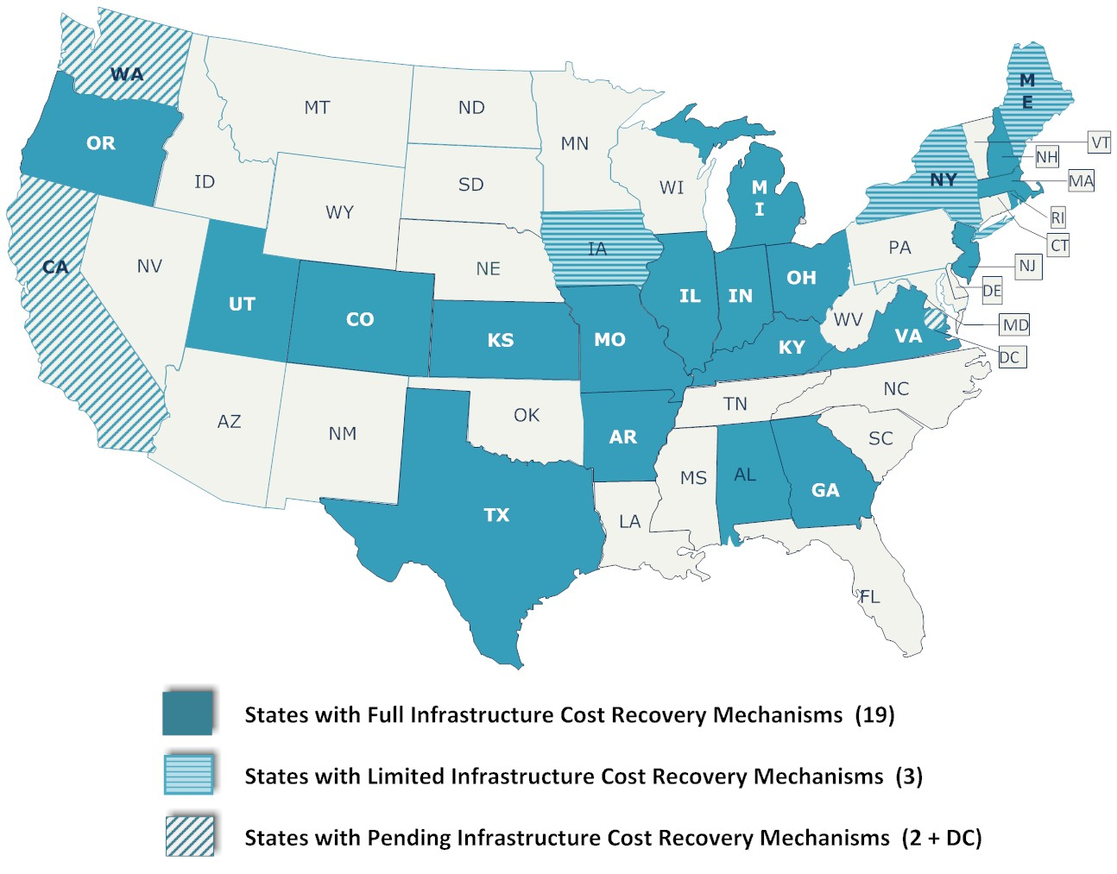
INFRASTRUCTURE COST RECOVERY
Mechanisms as of March 2012
Source: American Gas Association
Notes:
This map of the US shows those states with full or limited infrastructure cost recovery programs.
27 states already have infrastructure replacement cost recovery mechanisms, with 18 having a direct customer surcharge.
Pennsylvania’s Public Utilities Commission chairman, Robert Powelson is one of the most outspoken proponents of accelerated pipeline replacement programs with a customer surcharge mechanism.

Slide 5
State Update—Virginia
On the Right Path
SAVE
Passage of Steps to Advance Virginia’s Energy Plan (SAVE) in 2010 - HB 533 and SB 112.
According to the AGA, the Virginia legislative model is the most successful in the country.
No “caps” or limits on the customer surcharge.
Will condense a 50 year infrastructure replacement program into 5 years.
NEED
Passage of the Virginia New Energy and Economic Development (NEED) bills in 2012 - HB 559 and SB511
Allows natural gas utilities to expand infrastructure as necessary to provide natural gas to economic development projects where it is not already available, and when a project developer commits to at least a five-year contract for natural gas use.
Notes:
SAVE NOTES:
This 2010 law received strong bipartisan support in the House and Senate, and was successfully promoted by a coalition of natural gas companies and environmental organizations.
The company has begun replacing 445 miles of mains and 31,767 customer services, enhancing safety and reliability, and reducing greenhouse gas emissions.
AGA is circulating model cost recovery legislation for states to use when seeking cost recovery for infrastructure replacement. The model legislation is based largely on the VA SAVE law. (ALEC and Council of State Governments).
NEED NOTES:
The bill was a key part of Governor Bob McDonnell’s energy package, and serves the twin goals of providing incentives for economic development and extending natural gas service to historically underserved areas.
Under NEED, the natural gas utility constructing the eligible infrastructure shall be permitted to recover the “eligible infrastructure development costs” in future rates.
EIDC include: Return on Investment, A Revenue Conversion Factor, O&M Expenses, Depreciation and Property Taxes

Slide 6
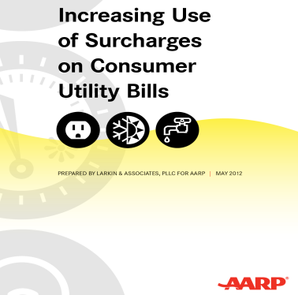
State Update—Maryland
More Work Remaining
STRIDE Infrastructure Legislation 2012
  Passed House by wide margin.
  Failed Senate by two votes on reconsideration.
  Will be reintroduced in 2013 session.
  Building wider alliances and strengthen existing ones.
  Stiff opposition from AARP
Gas Leaks – Trees & Vegetation - Introduced as HB 1199 in 2012
  Swiftly defeated within the House Economic Matters Committee.
  Advocates claiming gas leaks are “killing trees” and created widespread public hazards.
  Idea and legislation were sourced from a similar attempt in Massachusetts.
Notes:
STRIDE
2012 marked the second year that Maryland gas utilities attempted passage of infrastructure legislation.
In 2012, a strong House sponsor and committee chairman led the efforts to secure passage with a wide margin of victory.
On the Senate side, the STRIDE passed the Senate Committee, but was one of the most intense bills debated on the Floor, eventually losing by 2 votes under the reconsideration rule.
Strong opposition from AOBA and AARP. Moderate opposition from PSC after amending the bill.
New 2012 report from AARP suggest a national platform.
WG’s original 30-year $642 million accelerated replacement plan would have replaced over 600 miles of “mains” and over 60,000 customer services - more than 4 times our current levels. That’s equivalent to driving from Maryland to Maine and back.
STRIDE included many benefits appealing to Maryland:
reducing GHG emissions by 1.2 million metric tons over 30 years.
$160 million in minority, veteran or woman owned business spend.
200 long term construction jobs, with even more jobs created indirectly.
GAS LEAKS BILL
Bill would have placed a presumption of guilt on the gas company if a tree died, opening gas utilities to unlimited legal claims.
The Maryland legislation and “experts”, witnesses, etc. originated in Massachusetts and made their way to Maryland from a resident who felt the trees dying on her street were caused by gas leaks.
Gas companies successfully defeated the bill by exposing the “junk science” upon which the theory is based. The findings and “gas leaks maps” were discredited before the committee once we demonstrated that the map showed leaks where there were no gas lines (on draw bridges)

Slide 7
State Update—District of Columbia
Energy Efficiency Policy Focus
Legislative:
Legislation pending to allow for Community Energy Generating – Bill 19-715.
Solar and cogeneration personal property tax exemption legislation pending – Bill 19-749.
Regulatory:
Washington Gas called in by the PSC to file a rate case to investigate base rates.
  Case is currently underway in the discovery phase.
  A STRIDE-like infrastructure replacement surcharge is included in WGL’s filing.
  New Commissioner Nominee
Political:
Major political uncertainty in executive and legislative branches.
    Interim City Council Chairman
    Special election in November
    Mayor under investigation
Notes:
CLEAN ENERGY—COMMUNITY GENERATION
Legislation has been introduced to allow community renewable and net metering, allowing “virtual” ownership/partnership in solar and other renewable installations.
WGL has offered an amendment to include CHP installations in the “community generation” bill and to exempt CHP from the current personal property tax.
Strong legislative support to exempt solar power systems from a 3.4% personal property tax. The construction of larger systems typically require the involvement of third-party owners like Washington Gas Energy Services or Systems. This is especially true for projects involving government and non-profits who cannot benefit from the federal tax incentives vital to the economics of solar power.
BASE RATE CASE
The Public Service Commission “called in” WGL to investigate base rates
Company is seeking a $29 million increase. First in five years.
Included within the WGL base rate filing is an infrastructure cost recovery surcharge. Calls for a $119 million /5-year pipeline replacement plan.
WGL has had a limited-scope specially funded replacement program for several years which was approved by the Commission. The new request by WGL would bring the program in line with wide scale programs such as those being implemented in Virginia and other states with approved Plans.
Joanne Doddy Fort – Mayor’s first nominee was the former People’s Counsel for over 25 years. Nomination rejected.

Slide 8
Virginia, Maryland and DC
Infrastructure Replacement Plans
 | Virginia | Maryland | D.C. 1027
Initial Timeframe | 2010-2014 | 2012-2016 | 2010-2016
Initial Capital Expenditures | $116.5 mm | $115.0 mm | $28 mm
Total Plan | 15 Years | 30 Years | 7 Years
Jobs Created | 149 | 124 | n/a
GHG Emission Cumulative Reduction | Equiv. of 6,300 cars off the road | Equiv. of 7,917 cars off the road | n/a
Programs | Virginia | Maryland | D.C. 1027
Bare and/or Unprotected Steel Services | 18,000 | 20,000 | n/a
Bare and Unprotected Steel Mains | 37 miles | 152 miles | n/a
Vintage Mechanically Coupled Pipe | 34,250 services; 408 miles of main | 34,500 services; 401 miles of main | 3,455 services; 25.9 miles of main
Cast Iron Mains | n/a | 75 miles | n/a
Notes:
In the Maryland, Virginia and DC service territory of Washington Gas, we’re prioritizing accelerated pipeline replacement programs.
We’re expending significant financial resources as well as political capital to speed up the replacement of aging infrastructure.
We’ve been careful not to cry “fire in the theater”, but at the same time, we are doing all we can to educate policy officials and to a lesser degree customers about the need to modernize our natural gas infrastructure.

