Slide 1


2012 Annual Meeting
Energy Efficiency Opportunities and Challenges
July 10, 2012
  Sam Krasnow
  VP, Regulatory Affairs & Market Development

Slide 2

Commercial Building Energy Information Gap
In order for utilities to scale efficiency investments…
…we need actionable consistent building energy information
Meeting increasingly aggressive EE goals
Effectively target and engage large, medium & small businesses
Identify new and best opportunities
Track and attribute savings
Prove/facilitate persistence
Engage service providers
Why is the EUI so high in a partially occupied building?
What is the cooling efficiency?
Which program makes the most sense here?
Is the HVAC problem in the assets or the operations?
What is the source of the high baseload?
How to make the ROI case to the CFO?
What is the RCx opportunity? How hard is it to realize?

Slide 3
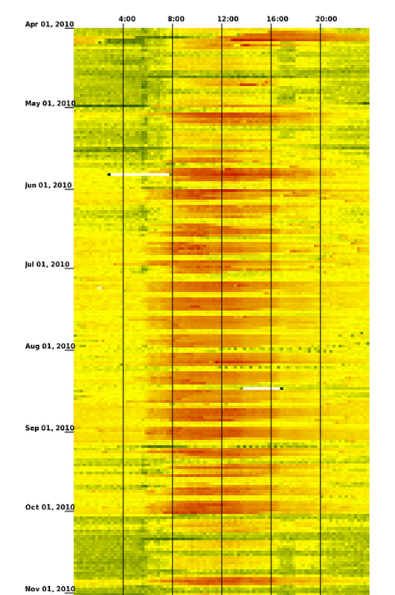
Interval Data + Advanced Data Analytics:
A Scalable Bridge for the Information Gap
FirstFuel uses utility data to produce building energy insight
Poor Cooling Efficiency-
Equipment Sequencing Issues
High Lighting Load
Simultaneous Heating & Cooling
Large Data Center
Economizers Not Working
24 Hour A/C-

Slide 4
What Can Analytics Do?
Segmented Commercial Engagement
Largest
(2MW+)
Large Account
Engagement
Portfolio Wide
Energy Analysis
Medium & Large Business
(100kW - 2MW)
Deep Engagement
Remote Building
Assessments (RBA)
(Tier 2)
Small Business
(<100 kW)
Broad Engagement
Comparative Energy
Benchmarking
(Tier 1)
  Supporting faster, broader, and deeper efficiency savings across all segments
Notes:
To address the broader Commercial Building Market, its important to recognize the different needs of business customers.
We therefore have developed a tiered offering to provider both large scale engagement and participation, while allowing medium and large customers to be provided with deeper insights and functionality into their energy performance

Slide 5
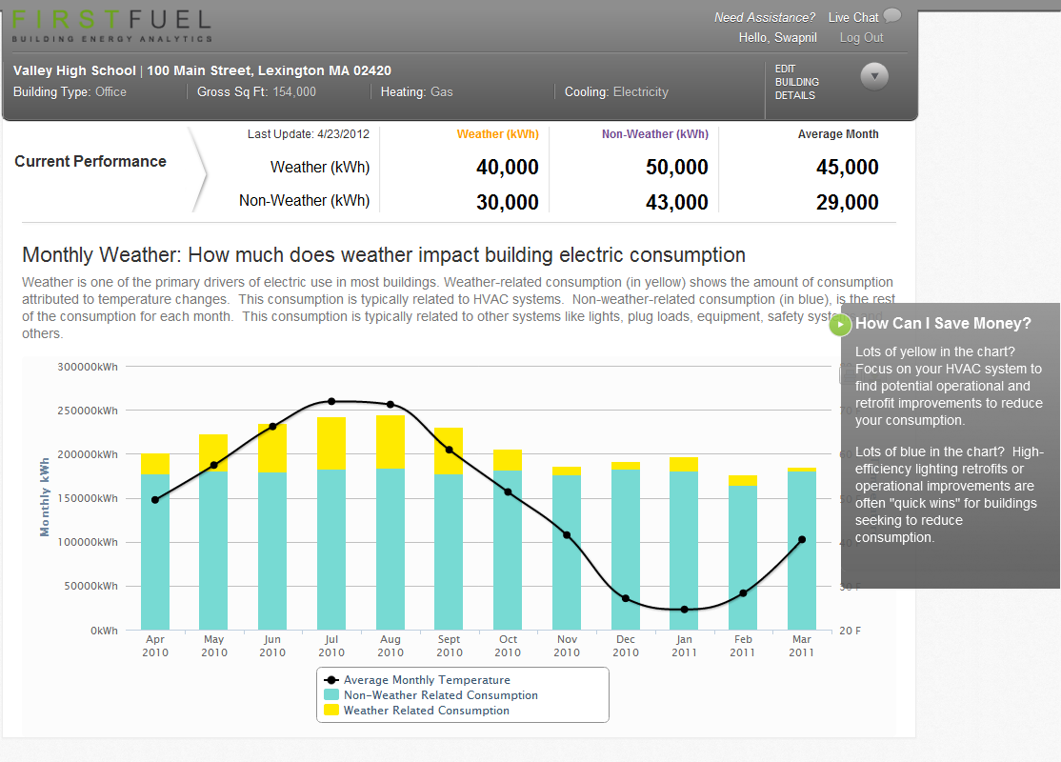
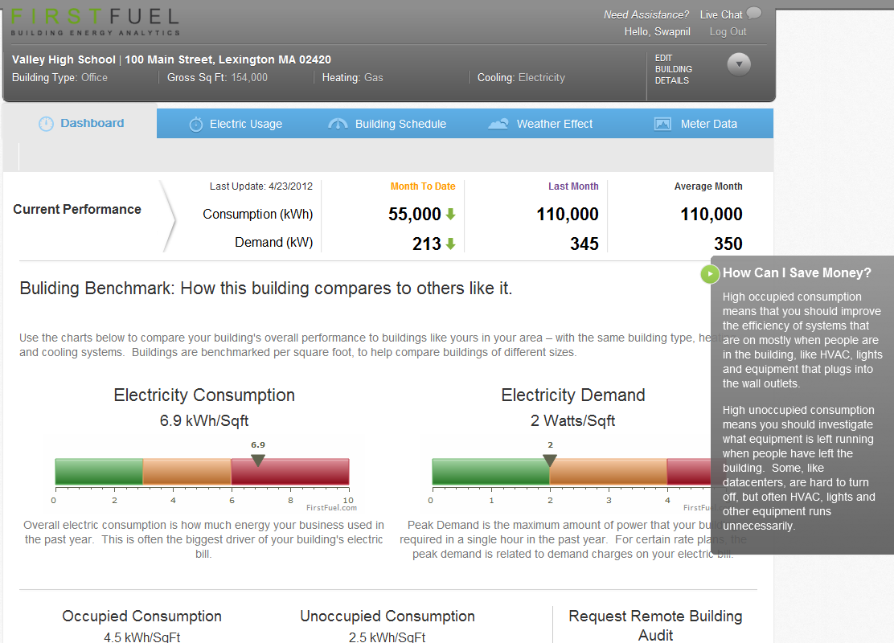
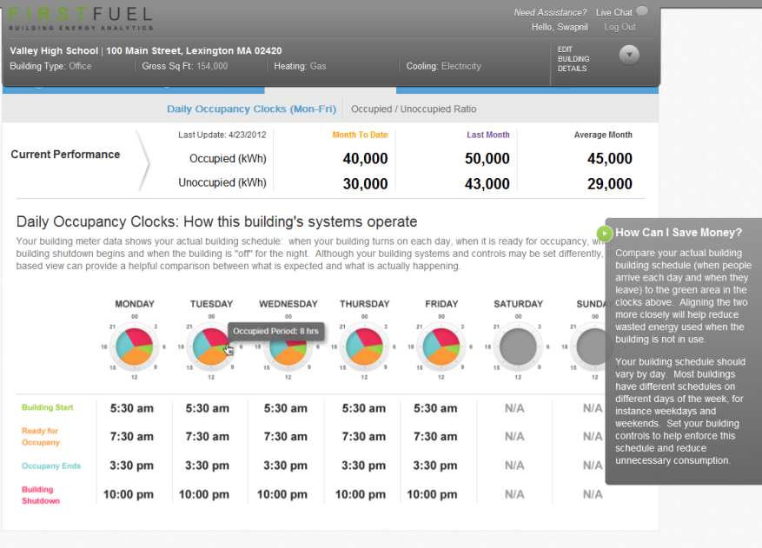
FirstFuel: Broad Engagement
Use Commercial Customer Insights to Drive Program Participation, EE Goals
  Intelligent Benchmarking Against Historical and Peer Usage, Demand
  Analytics into Operations and Weather
  Connects customized insights directly to utility programs: Efficiency, Demand, others
  For every commercial customer
Notes:
Our entry level offering is designed for broad engagement – with all C&I customers from the smallest pizza store to the largest convention center.
It provides a benchmark of how a business uses energy, against their peers, as well as against themselves historically.
This is the first energy engagement platform for business customers – helping small customers understand their usage and leverage programs, and driving medium and large businesses to dig deeper

Slide 6
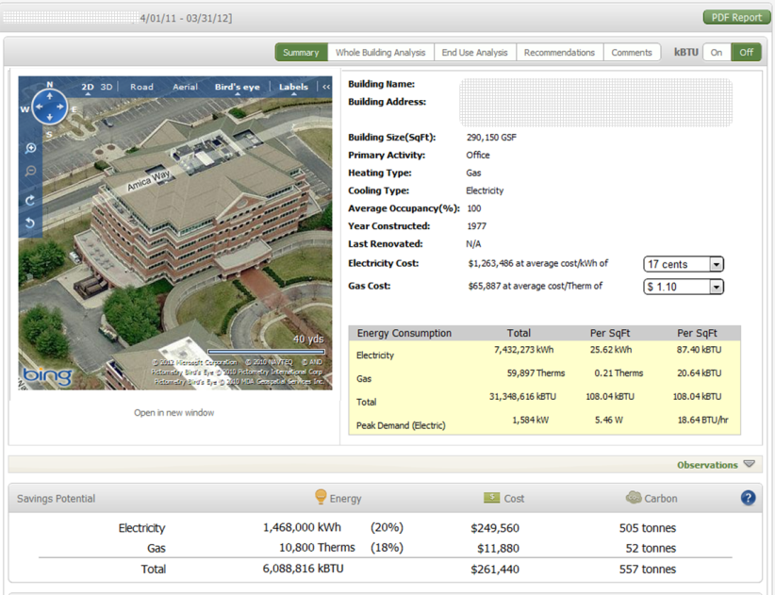
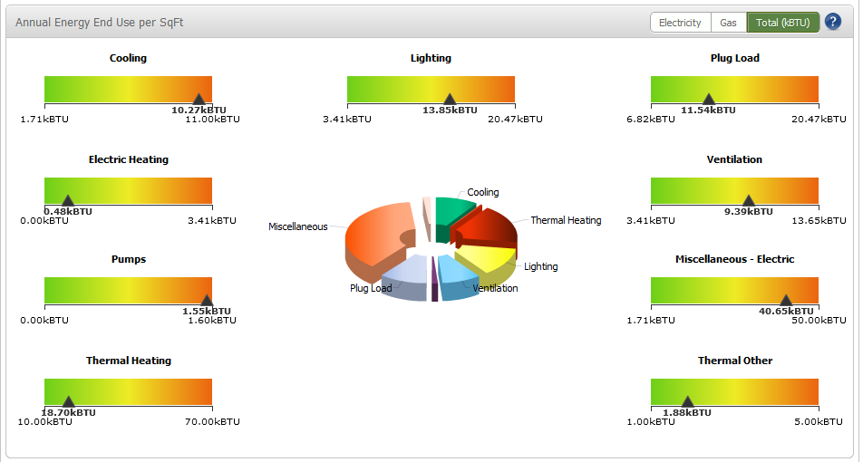
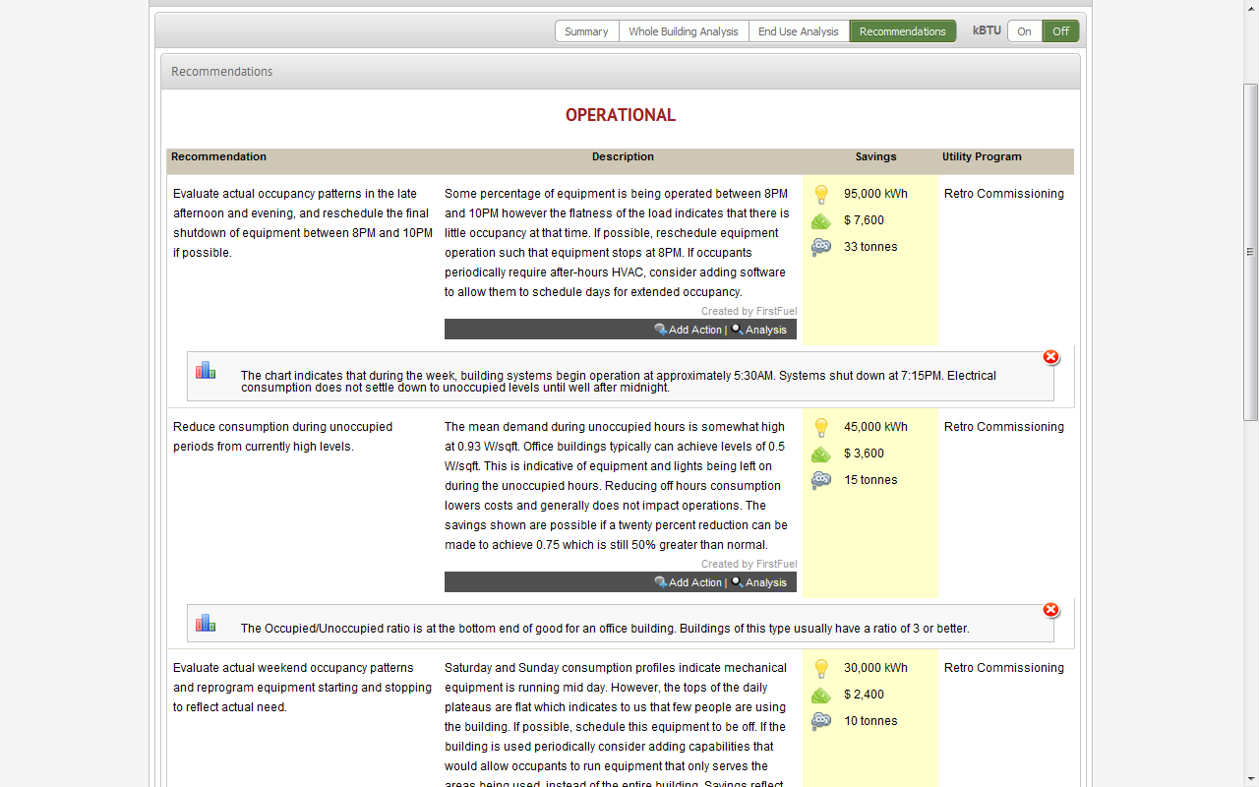
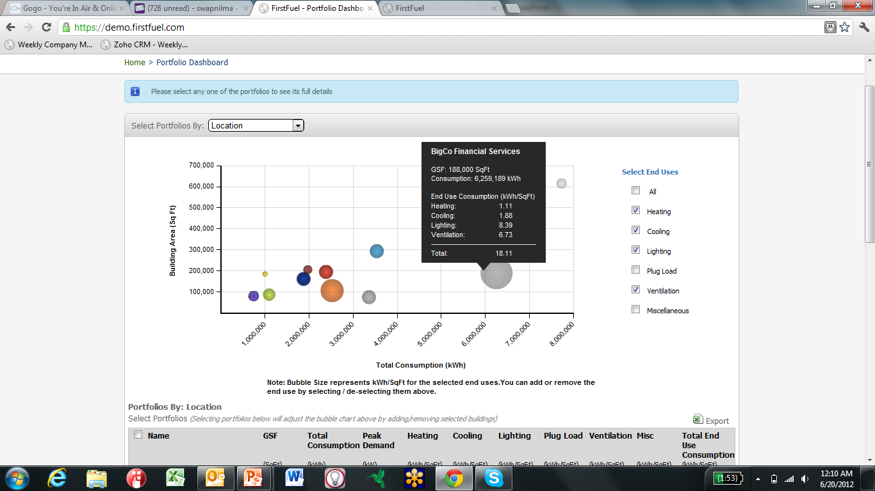
FirstFuel: Deep Engagement
Patented Interval Data Analytics Create Remote, Audit Quality Information
Whole Building Savings Analysis
End Use Benchmarking
Customized Operational & Retrofit Measures
Portfolio-Wide Investment Prioritization

Slide 7


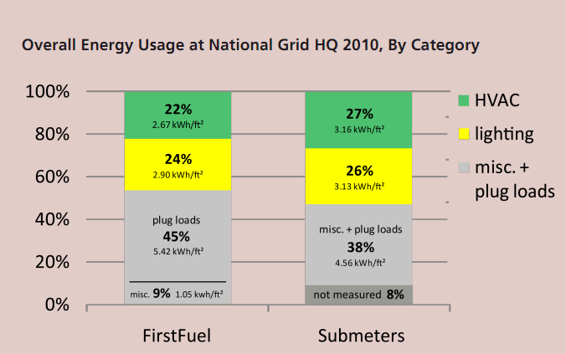
Independent Technical Validation
Fraunhofer/US Dept of Energy Study
“As demonstrated in this study, the remote disaggregation technique developed by FirstFuel has the potential to be a valuable engine for large scale benchmarking of buildings and to identify energy-saving opportunities without on-site audits.”

Slide 8
Sample Pilot Results: Engaged Customers
6-8x Improvement in EE sales cycles
End-customers engaged from Day 1, immediate operational actions
~15- 20% portfolio savings identified
50/50 split between operational/retrofit ECMs

