Slide 1
Advancing Energy Efficiency in Massachusetts and New England
USGO Annual Meeting 2012
July 10, 2012
Jeremy C. McDiarmid
Massachusetts Director

Slide 2
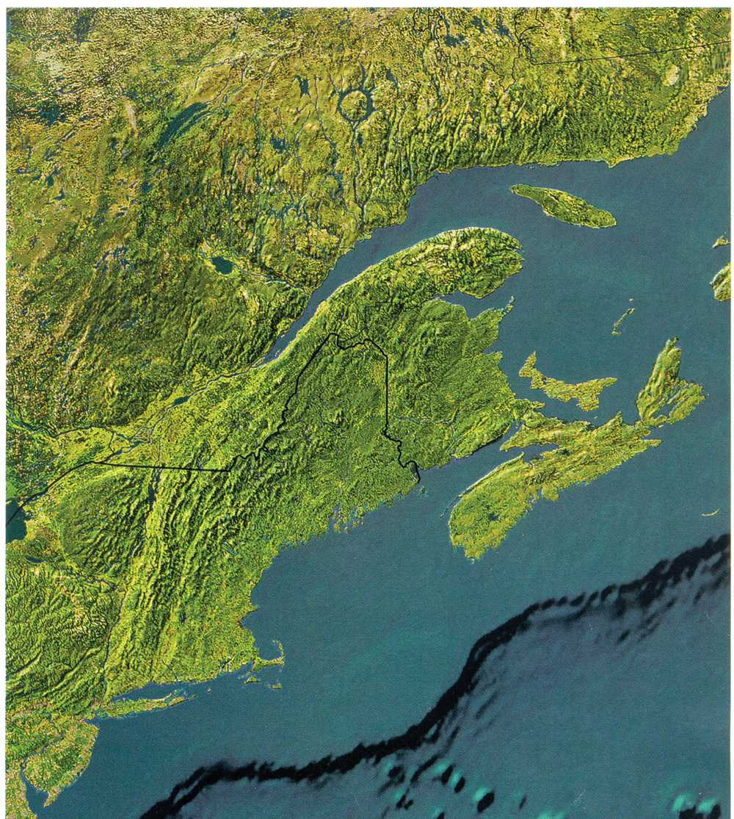
ENE
Environmental policy, research, & advocacy
Rockport, ME / Portland, ME / Boston, MA / Providence, RI / Hartford, CT / Ottawa, ON, Canada
Program areas:
  Energy policy
  Climate change
  Transportation & diesel
  Forest practices & land use
Notes:
2

Slide 3
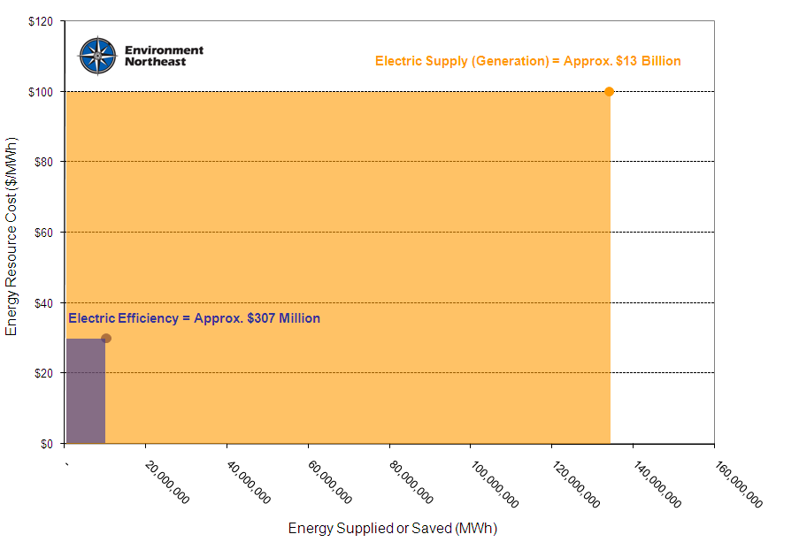
Policy Goal: Adopt All Cost Effective Efficiency

Slide 4
Energy Efficiency Policy Drivers
Efficiency as an Energy Resource
  All Cost-Effective Efficiency Mandate
Stakeholder Council
  Broad Stakeholder Representation
  Expert Consultants
Aligning Utility Economic Interests
  Performance Incentives
  Revenue Decoupling

Slide 5
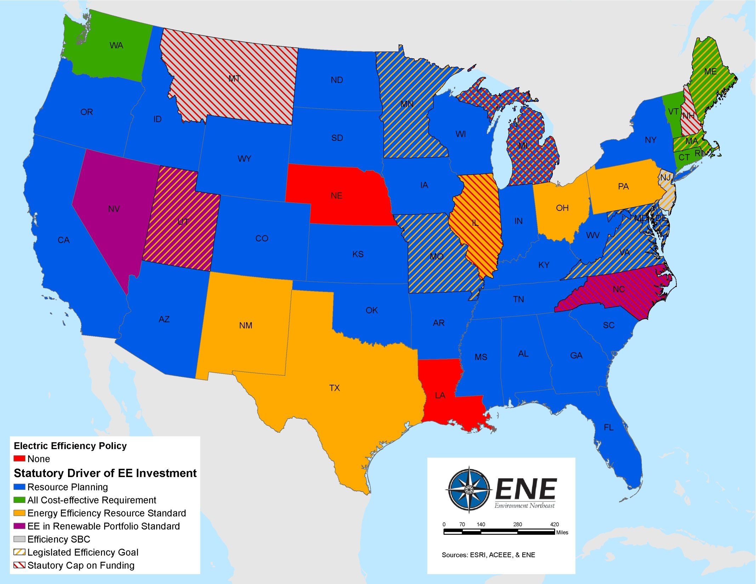

Slide 6
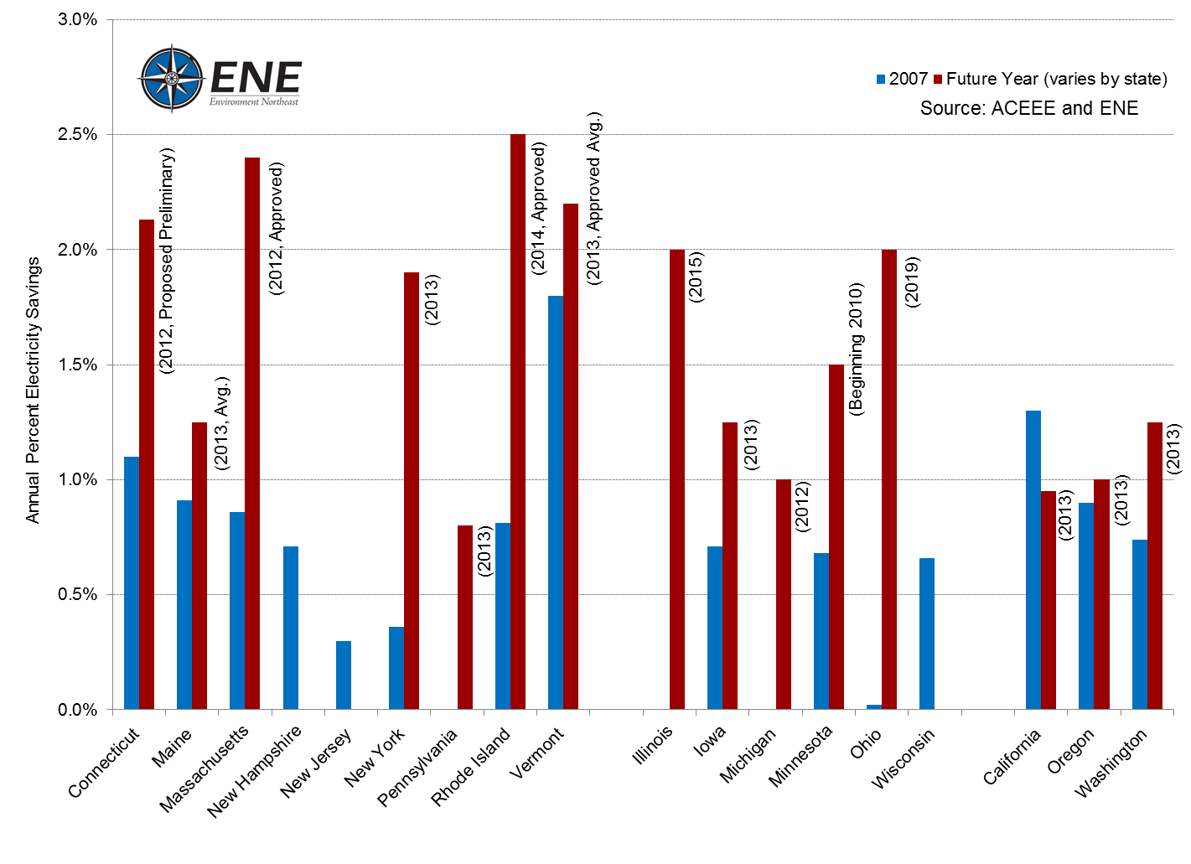
Outcome: Annual Savings Goals

Slide 7
Contact Info
Jeremy C. McDiarmid
Massachusetts Director
(617) 742 0054 x102
jmcdiarmid@env-ne.org
ENE (Environment Northeast)
Rockport, ME / Portland, ME / Boston, MA
Providence, RI / Hartford, CT / Ottawa, ON, Canada
www.env-ne.org

