Slide 1
2012 USGO Annual Conference:
Perspectives on Plug-in Vehicles
July 10, 2012
0

Slide 2
NU’s platform for plug-in vehicles
Anticipate and address T&D infrastructure requirements
Ensure alignment of utility assets with customer charging requirements
Achieve a regulatory framework for the EV sector that is based on sound utility practices and policies
Leverage EV technologies to enhance customer satisfaction

Slide 3
Top State Legislative Issues
Status of Electric Vehicle Service Providers (EVSPs)
Regulated as utilities or not?
Considered electric resellers or not?
Role of Utilities
Permitted to explore charging business models or not?
Sole Provider of electricity status protected?
Road Taxes
Early Notification efforts (Access to DMV Records, etc.)
Economic Development
State Collaborations & Advisory Councils

Slide 4
Top State Regulatory Issues
Status of Electric Vehicle Service Providers (EVSPs)
Regulated as utilities or not?
Considered electric resellers or not?
Role of Utilities
Permitted to explore charging business models or not?
Education or other responsibilities
Sole Provider of electricity status protected?
Cost Recovery
Rates (max benefits to customers, min costs to utility)
Metering (sub-metering, costs)
Early Notification

Slide 5
Follow the money
Utilities
Negligible near-term revenues
Long-term regulated revenues good for ratepayers
Automakers
Negligible near-term revenues with large development costs
EV Service Providers
Several received significant amounts of federal funding
Still exploring sustainable business model
Private Equity / Capital Markets
Federal Grants
Vehicle Incentives
Limited pure play opportunities
Infrastructure funding went to charging equipment suppliers which preselected winners
$7,500 Federal tax credits for the purchase of a plug-in
Vehicle funding went to technology research
Billions went to Tesla, Fisker, Better Place, Coulomb and others
NRG’s EVGo network
Electrical Equipment
Big players (GE, Schneider, ABB, Siemens) were slow to market
Most charging stations in service now are from start-ups
Not all automakers are the same, some just view this as compliance cars or “halo” vehicles

Slide 6
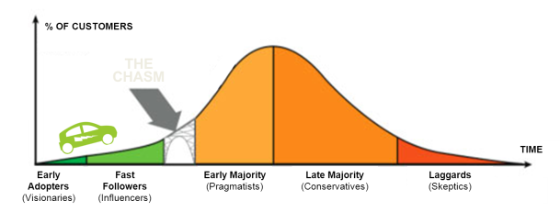
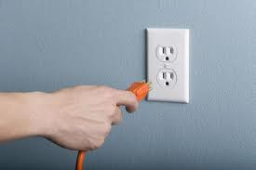
Realities
Adoption rates in automobile market
Average age of vehicle on the road is 10.8 years old
Hybrids took about 10 years to achieve 1% share of the vehicle stock
Plug-in sales are expected to be sensitive to incentives and gasoline prices
Residential charging works
15¢ per kWh electricity equals roughly $1.00 a gallon gasoline
Don’t need to figure out a business model for the plug at home
Business model for public access stations
Utilization rates for stations are limited by time it takes to charge a vehicle
High fixed costs could add about $1.00 per kWh ($1.00 per kWh equates to $8.00 per gallon of gasoline)
Pricing EV charging at the price of gasoline still may not provide adequate returns for investors

Slide 7
Optimism in policy arena
Occasional policy bias towards Battery Electric Vehicles (BEV) over Plug-in Hybrids (PHEVs)
Desire in some circles to have BEVs do everything a conventional vehicle does, which leads to significant infrastructure needs
Planning groups and efforts have been initiated in a lot of communities to develop infrastructure plans
Strong desire for a free market solution
Vehicle to Grid and wireless charging

Slide 8
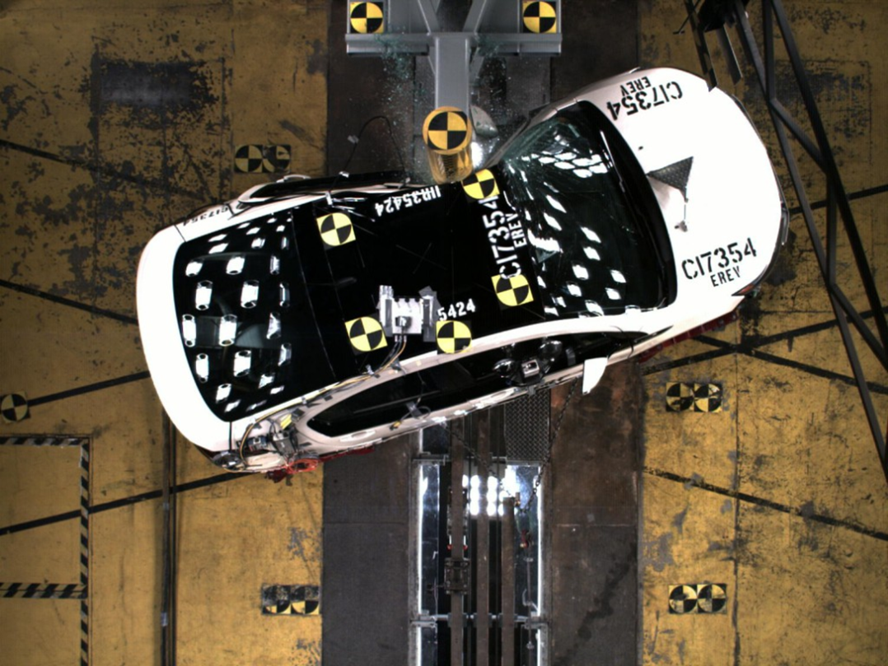
Politics of Plug-in Vehicles
Election year politics
News reports of fires
Petroleum industry
NGOs looking to align with utilities
Utilities can be the voice of reason
with policymakers and customers

Slide 9
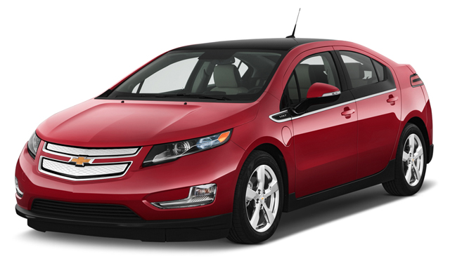
Higher Sales in 2011?
Notes:
Chevy Volt 7,671
Porsche 911 6,016
Toyota Land Cruiser 1,662
1st year Prius sales in US were 5,600
Nissan Leaf 9,674

Slide 10
Why utilities should care
Defensive
Offensive
The utility infrastructure needs to be ready
Policy approaches are being set now, difficult to change course later
New circumstances, old issues (metering, sale for resale, taxes)
Opportunity to lead an issue generally viewed as positive
Long-term market potential
Captures the synergies of off-peak charging with the utility infrastructure

Slide 11
We believe there is an incredible synergy for overnight plug-in vehicle recharging
Consumer
Realities
Environmental
Benefits
Electric
System
Optimization
Consumer Realities
Most economical recharging costs
Daily driving is typically less than 40 miles total
Parked for hours while you sleep
Not going to gas station: unexpected consumer benefit
Environmental Benefits
Plug-in vehicles have low emissions
The emissions profile of electricity generation varies by region, time-of-day and season (New England is cleaner than average)
Electric System Optimization
Given the existing infrastructure, only the last 50 feet need to be built
Capacity exists on the utility system in overnight periods
Plug-in vehicle recharging can reduce electric rates if done right (broader cost allocation)

Slide 12
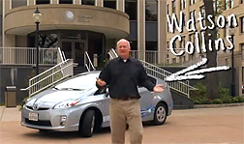
Questions?
Watson Collins, P.E.
Manager, Business Development
watson.collins@nu.com
@WatsonCollinsNU
860.728.4843
http://www.youtube.com/watch?v=0NaI9SYhN34

Slide 13
REVI utilities working group has operations in 5 states
Northeast Utilities (CT, MA & NH)
National Grid (MA, NH, NY & RI)
NSTAR (MA)
United Illuminating (CT)
Municipal utilities (CT & MA)

Slide 14
REVI’s new website offers free download of “Metering for EV Charging Stations” discussion paper
◄ Download pdf
at www.REVI.net
“EVs and Electric Utility Meters:
A Discussion of Data Requirements and Options for
Metering Electric Use by Plug-In Electric Vehicles”

Slide 15
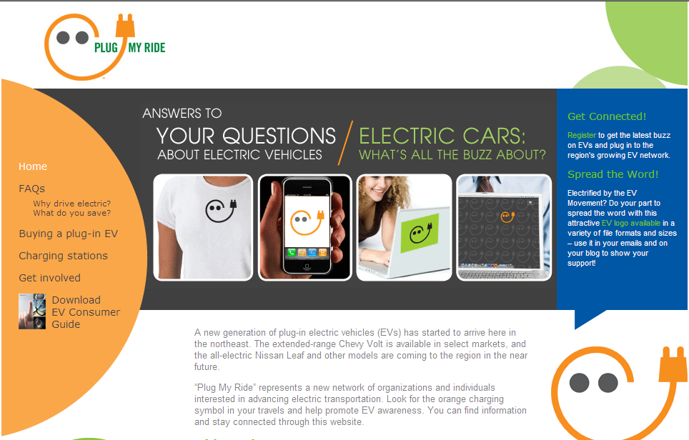
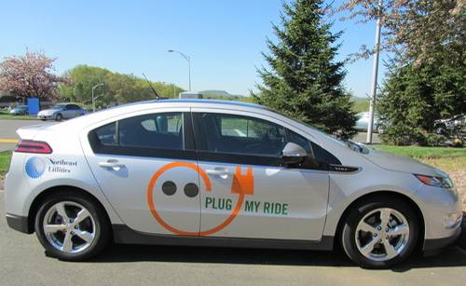
Plug My Ride campaign has been launched
Website
http://www.plugmyride.org/
Charging
Station
Signage
Poll Question #4

Slide 16
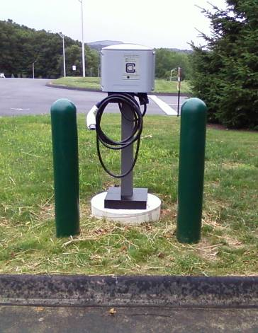
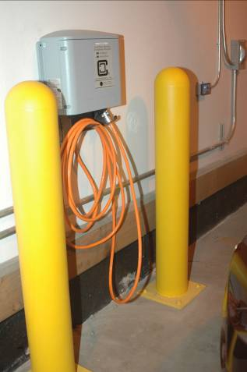
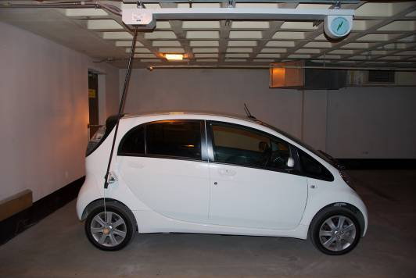
Testing vehicles and EVSEs on our own property
Vehicles
Initially secured demonstration vehicles from automakers for temporary use
Recently acquired Chevy Volts from EPRI program
Installed EVSEs at corporate offices in 3 states
6 stations currently installed
Purpose of this phase
Gain experience with equipment by multiple vendors
Install equipment to learn about installation process and costs
What we learned
Wiring costs varied dramatically
Civil works add significant cost if required
Not all equipment is UL listed and is in varying stages of commercialization

Slide 17
We are working with customers to install EVSEs at public locations
Provide EVSEs to “early adopter” sites
20-25 business and municipal sites
Relying on “pull” from customers instead of utility “push”
Customer responsible for wiring, installation & electric use
Purpose of this phase
Install equipment at non-NU locations to learn about customer process and costs (permitting, metering options, different installation locations / configurations)
Identify metering options

Slide 18
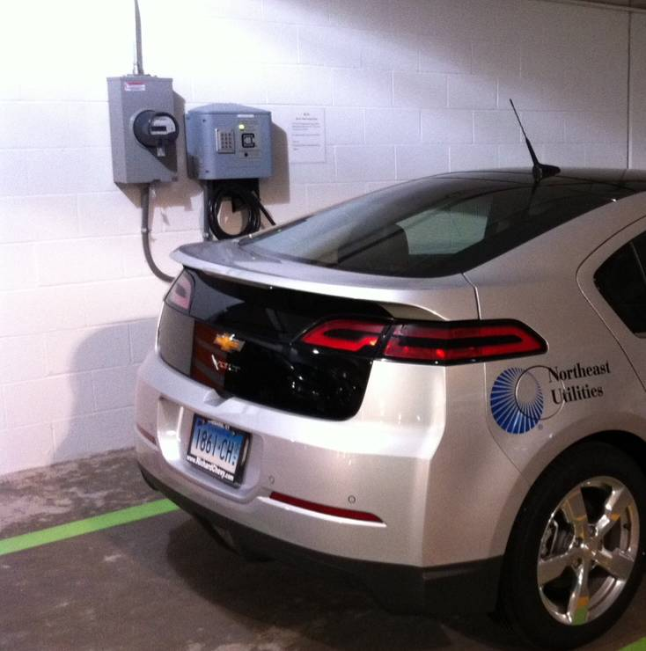
Current research project - garage installation
Deconstructed “full featured” EVSE
Basic EVSE provided by Clipper Creek
Separate meter – Load research meter with cell phone connectivity
Data access thru existing company web portal
Optional – Access control keypad provided by Liberty Plugins
Optional – Payment Systems from Mobile Now and Park Mobile

