Slide 1
EEI Update
USGO
Sarah Lashford and Brad Viator

Slide 2

Campaign Update

Slide 3
Web Site Co-Branding:
40 EEI Companies To Date
American Electric Power
Alliant Energy
Ameren
Avista
Black Hills
CenterPoint Energy
Cleco
ConEd
Dominion
DTE Energy
Duke Energy
Duquesne Light
Edison International
Empire District
Energy Future Holdings
Entergy
Exelon
Great Plains/KCP&L
Hawaiian Electric
IDACORP/Idaho Power
Integrys
NextEra Energy
NiSource
NorthWestern Energy
NV Energy
Otter Tail
Pacific Gas & Electric Company
Pepco
Pinnacle West Capital Corporation
PNM Resources
Portland General Electric
PPL
Progress Energy
PSEG
Southern Company
Teco Energy
UIL Holdings Corporation
Westar Energy
Wisconsin Energy Corporation
Xcel

Slide 4
Coalition Allies
Alliance for Savings and Investment
Alliance for Utility Shareholder Associations
Altria
American Gas Association
National Association of Water Companies
New York Stock Exchange
Nuclear Energy Institute
SIFMA
UPS
US Telecom Association
Verizon

Slide 5
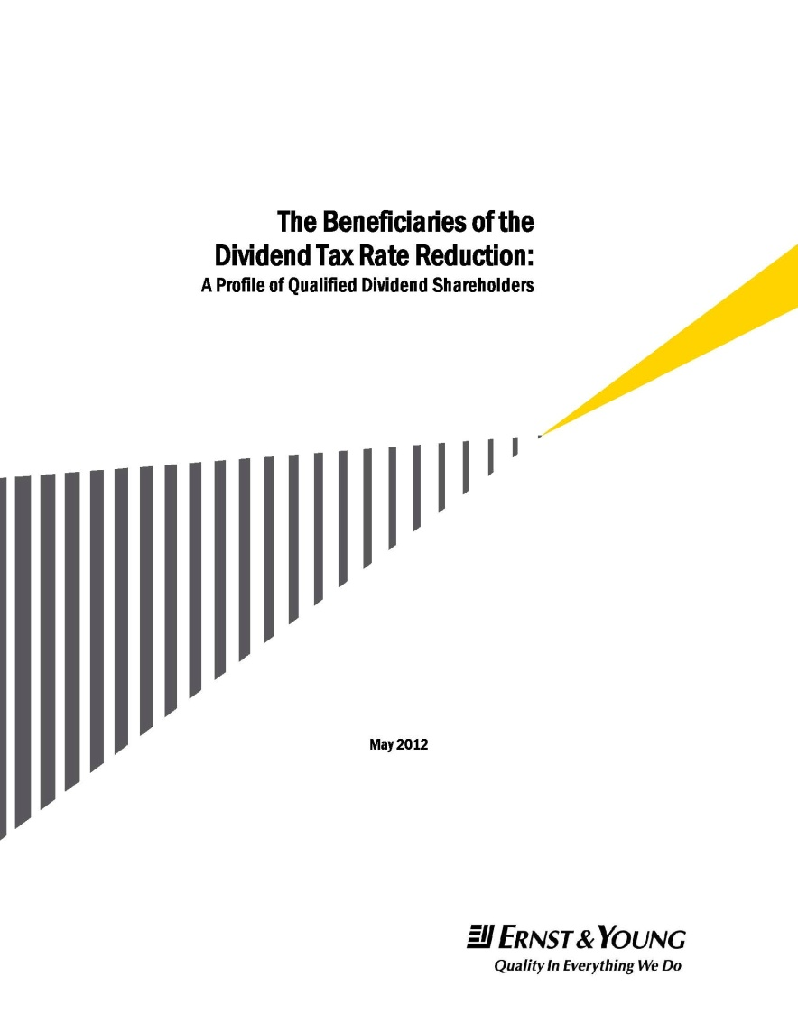

Release of Ernst & Young Study
July 12 • 1:30 p.m.
Capitol Visitors Center

Slide 6
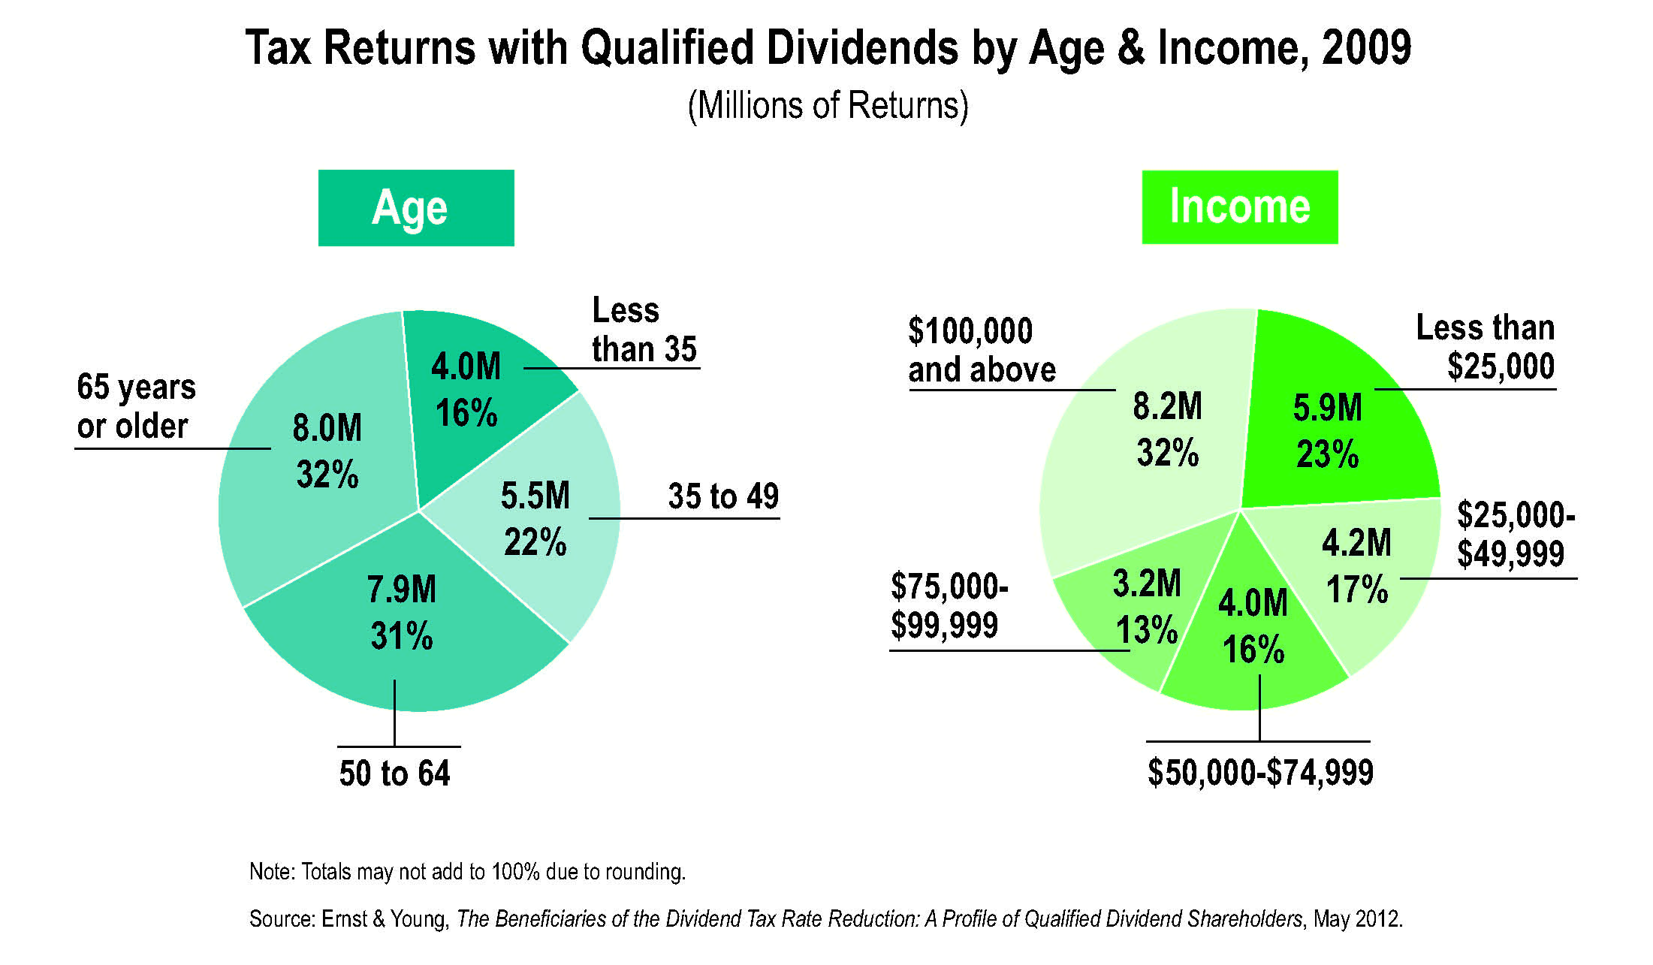
25.4 Million Tax Returns Had Qualified Dividends in 2009
Notes:
These two pie charts show the age and income break-down for all tax returns with qualified dividends in 2009, the latest year for which IRS data are available.
As you can see, dividend-paying stocks are held by individuals spanning all age ranges and income levels.

Slide 7
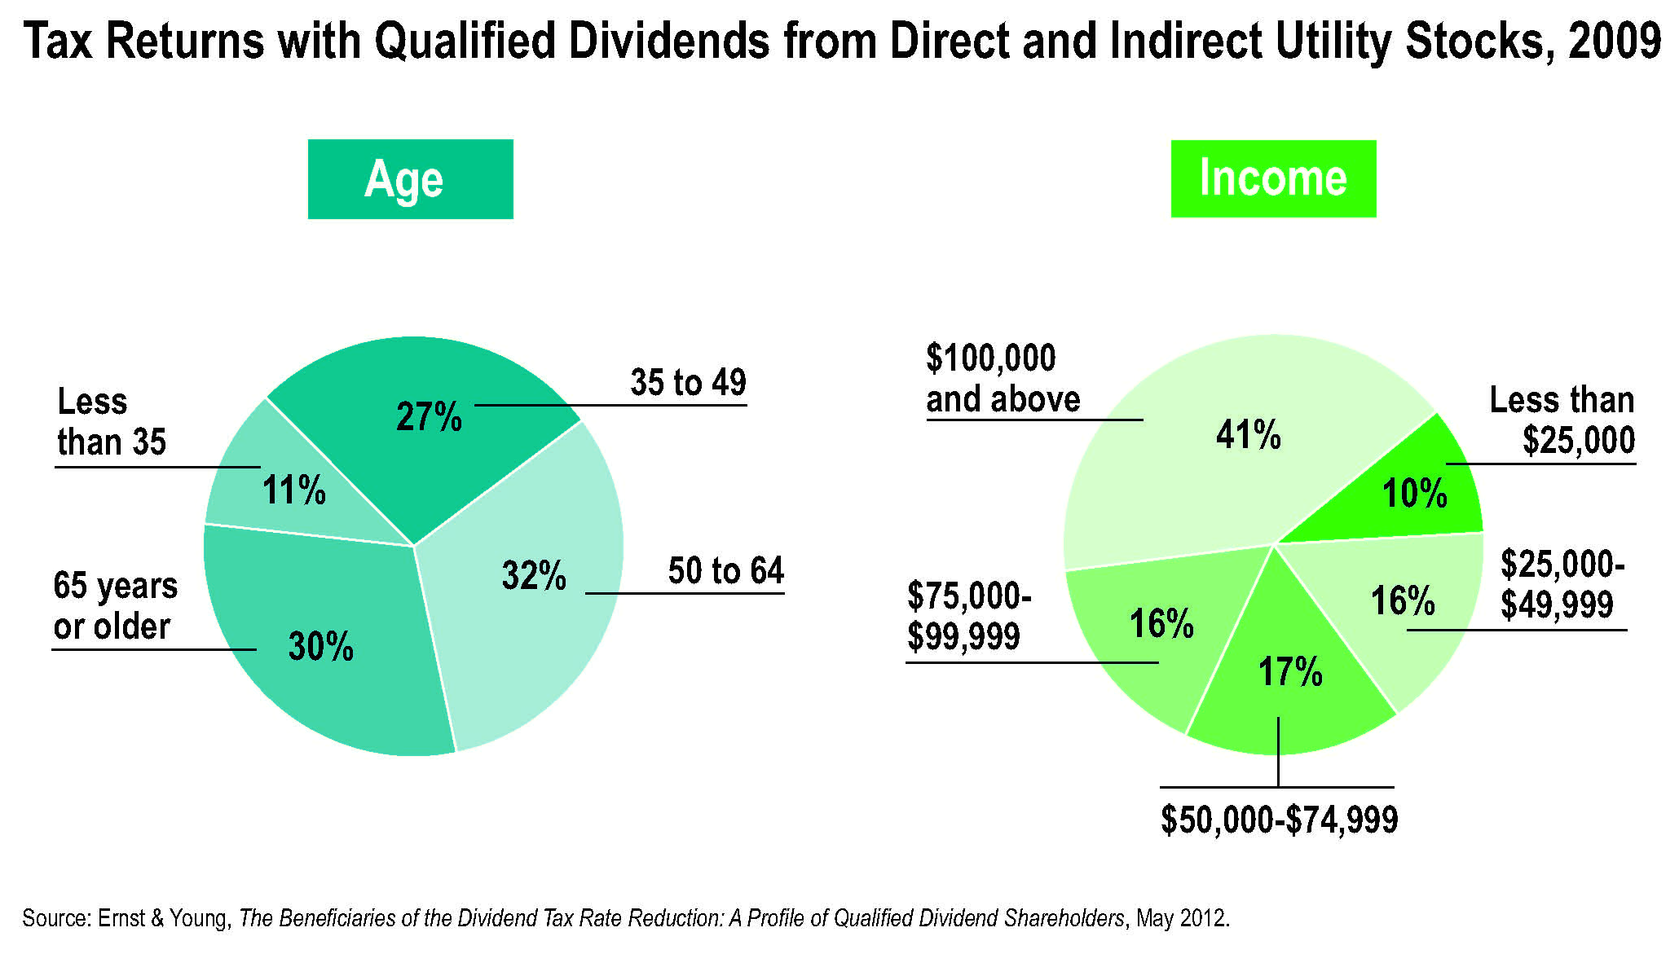
61 Percent Of Tax Returns With Qualified Dividends Are Estimated To Have Some Utility Holdings
Notes:
These pie charts give us more information about the individuals with qualified dividends from direct and indirect utility stocks.
More than 60 percent of all tax returns with qualified dividends had some utility stocks.
As you can see, 62 percent of tax returns with qualified dividends were filed by investors age 50 and older. And, 59 percent of those tax returns were filed by taxpayers who made less than $100,000 a year.

Slide 8
Call to Action!

Slide 9
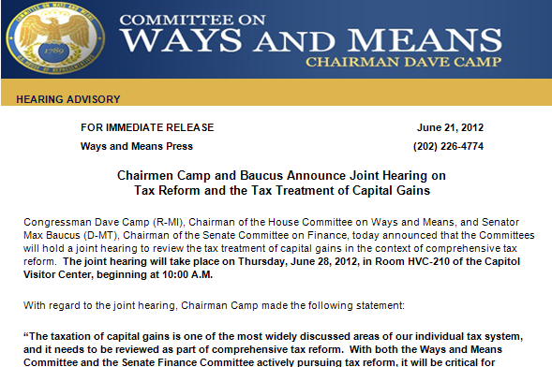
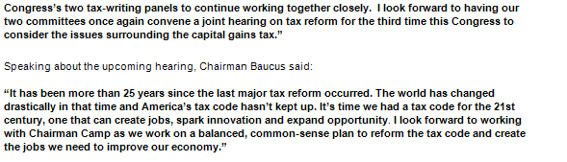

Slide 10
Outreach in July and August Is Key to Success
July
  Possible Vote in the House
  EEI member companies activate employees, shareholders, and retirees
  July 12: Congressional briefing on Ernst & Young study at
  Capitol Visitors Center
  July 17: EEI Leadership CEO fly-in on Capitol Hill
  EEI member companies meet with congressional delegations
  EEI outreach at RLCC, NARUC, NGA, DGA, ALEC, DLCC, CSG, and National Black Chamber of Commerce
  Begin paid media campaign (continues through September)

Slide 11
Outreach in July and August Is Key to Success
  August
    August 6-Sept. 7: Congressional Recess
    “Dividends In The District”
      EEI member companies create Dividend Action Teams to attend town hall meetings, meet & greets, “Congress on the Corner” opportunities, and district visits with Members and staff
      Outreach to local media
      Grassroots activities with allies
    Outreach to NCSL, Southern Governors’ Association, State Legislative Leaders Foundation
    August 26-30: Republican National Convention
    (September 2-6: Democratic National Convention)

Slide 12
Television Ad

Slide 13
“Disappear”
https://www.youtube.com/watch?v=nSmYM1w4h1A

Slide 14
316(b), Coal Ash, Utility MACT update

Slide 15
316(b)
EPA released a Notice of Data Availability on 316(b) in June, with a comment period that closes on July 12
Highly likely EPA will negotiate with the environmental community to delay the rule, the deadline was July 27
EEI is working with industry partners to get a rule out sometime before the 2012 elections

Slide 16
Coal Ash
Unfortunately Coal Ash language was dropped in the eleventh hour from the Transportation Bill two weeks ago
EEI and member companies are looking for alternative legislative vehicles to attach the necessary coal ash language

Slide 17
Utility MACT Implementation Update
Compliance Dates and Extension Possibilities
  Normal MACT timing: 3 years after final rule effective date (i.e., April 2015) [CAA sec. 112(i)(3)(A)]
  Possible 4th year: EPA Administrator (or approved State Program) can grant a 1-year extension if more time is “necessary for the installation of controls” [CAA sec. 112(i)(3)(B)]
    Extensions granted on case-by-case basis
  Possible 5th year plus:
    Instead, EPA has indicated it will use CAA section 113 Administrative Orders for sources that “must operate in noncompliance” (e.g., past a 4th year extension). EPA intends to limit applicability only to cases with a “specific and documented reliability concern.”
There are 3 legislative proposals in Congress
  Inhofe CRA disapproval resolution
  Alexander-Pryor blanket 6 year timeline
  Manchin-Coats extend and harmonize MATS and CSAPR to 2017

Slide 18
Thank You
Sarah Lashford
Director, External Affairs
Edison Electric Institute
202-508-5201
slashford@eei.org
Brad Viator
Director, External Affairs
Edison Electric Institute
202-508-5203
bviator@eei.org

