Slide 1
Nuclear Energy Institute
Christine Csizmadia
Senior Director, State Government Affairs & Advocacy

Slide 2
Electric Utilities are Planning for New Nuclear
Nuclear power’s potential role in meeting their company’s decarbonization goals:
>90% of fleet expects to operate to at least 80 years
90 GW of new nuclear opportunity by 2050s
Translates to nearly 300 SMR-scale plants
SLR
GW
SMRs
* - NEI utility member companies produce nearly half of all US electricity
NEI Overview of Demand::https://www.nei.org/CorporateSite/media/filefolder/advantages/The-Path-to-Decarbonization-Overview-of-the-Demand-for-New-Nuclear.pdf

Slide 3
Key Federal Policy Developments
Bipartisan Infrastructure Bill
Inflation Reduction Act
Civil Nuclear Credit Program
$6B to support financially challenged plants
ARDP Funding
$2.5B funding for two projects
Nuclear Hydrogen Hub
$8B total in the bill
Production Tax Credit (PTC) for Operating Plants
Up to $15 per MWh
Technology-Inclusive PTC for Clean Electricity
$30 per MWh
Technology-Inclusive Investment Tax Credit (ITC) for Clean Electricity
30% + 10% in energy communities + 10% using
U.S. components
Clean Hydrogen Credit
$3 per kilogram

Slide 4
Report available at https://liftoff.energy.gov/

Slide 5
Advanced Nuclear Deployment Plans
Projects in planning or under consideration in U.S. and Canada >20; Globally >30
State action or stakeholder interest in advanced reactors
Planned or considered project
Under construction
Updated 2/28/2023

Slide 6
2023 State Policy Trends
200+ bills introduced that impact nuclear
Nuclear Moratorium Repeals
Clean Energy Standards and Definitions
SMR Studies
Task Forces, Working Groups, Commissions
Used Fuel and Decommissioning
Workforce Development
Regulatory Reform
Advanced Nuclear
Hydrogen
Fusion
Notes:
Nuclear Moratorium Repeals – IL, CA, OR, MN
Clean Energy Standards and Definitions – VA, MN, NH, CT, MA, CO, TN, AZ, NM, ID, ND, MO
SMR Studies – SD, OK, MN, NY, ME, TX
Task Force – NE, CT
Used Fuel – NM, AR, MA, FL, NY
Hydrogen – NE, MN, WV, MO
Workforce – WA, NE, VA, WV, SC
Regulatory Reform – WY, IN, VA, WV, IL
Advanced Nuclear – WA, WV, VA, IN, MN, NY, OK, CT, SD, IL, OR, ME, NE, MO, CA, TX, ND, FL
Other: CT, study, working group and DEEP study for Millstone reliability, PPA extension

Slide 7
2023 State Actions for Nuclear Energy
CES and Defining Clean
Minnesota, Idaho
Workforce Development
Virginia, West Virginia
SMR Incentive
Indiana
SMR Study
North and South Dakotas
Moratorium Repeal
Illinois
Hydrogen/Nuclear
Nebraska
Nuclear Working Group
Kentucky, Connecticut
Energy Study
Colorado
Coal to Nuclear
Texas
Fuel Recycling
Arkansas
Nuclear Energy Caucus
Washington, Texas, Michigan

Slide 8
2023 Governor Actions
Tennessee’s Governor Lee’s $50 Million for Incentives and Nuclear Energy Advisory Council
Virginia’s Governor Youngkin’s $5 Million for a Nuclear Innovation Hub
Michigan’s Governor Whitmer $150 Million for re-activating Palisades in state budget

Slide 9
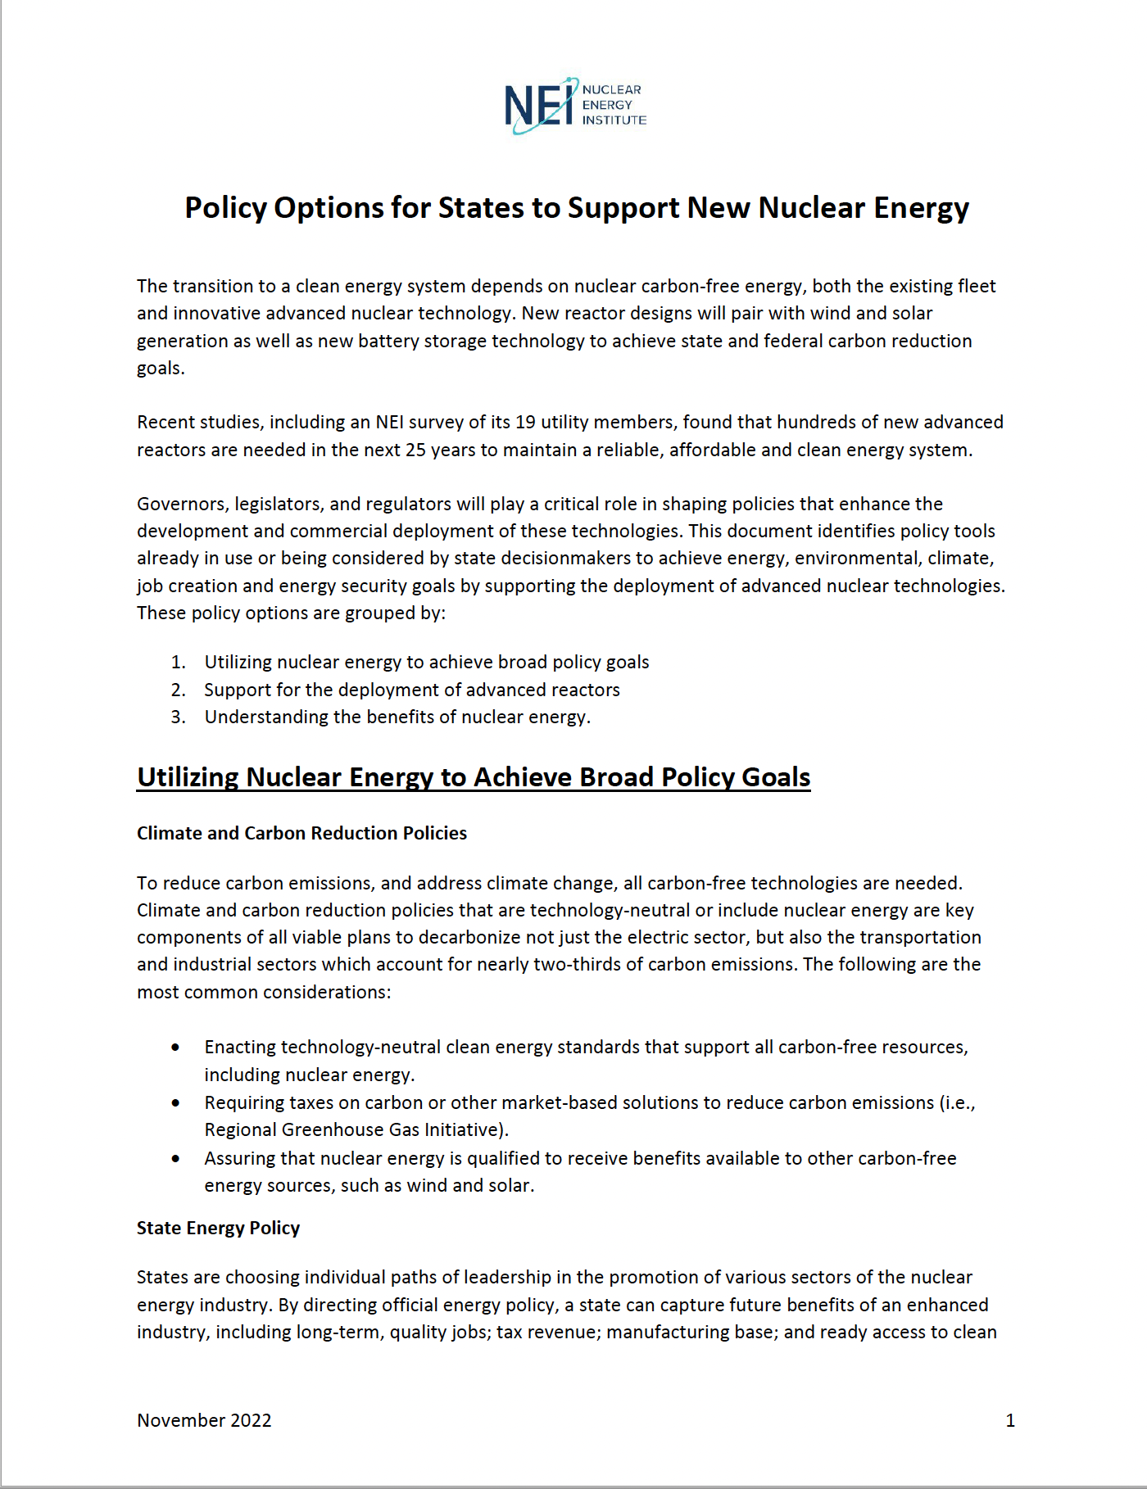
State Options to Support Advanced Reactors
Feasibility Studies
Reducing Barriers
Tax incentives (e.g., property)
Advanced cost recovery
Workforce and infrastructure
State Policy Options: https://www.nei.org/resources/reports-briefs/policy-options-for-states-to-support-new-nuclear

Slide 10
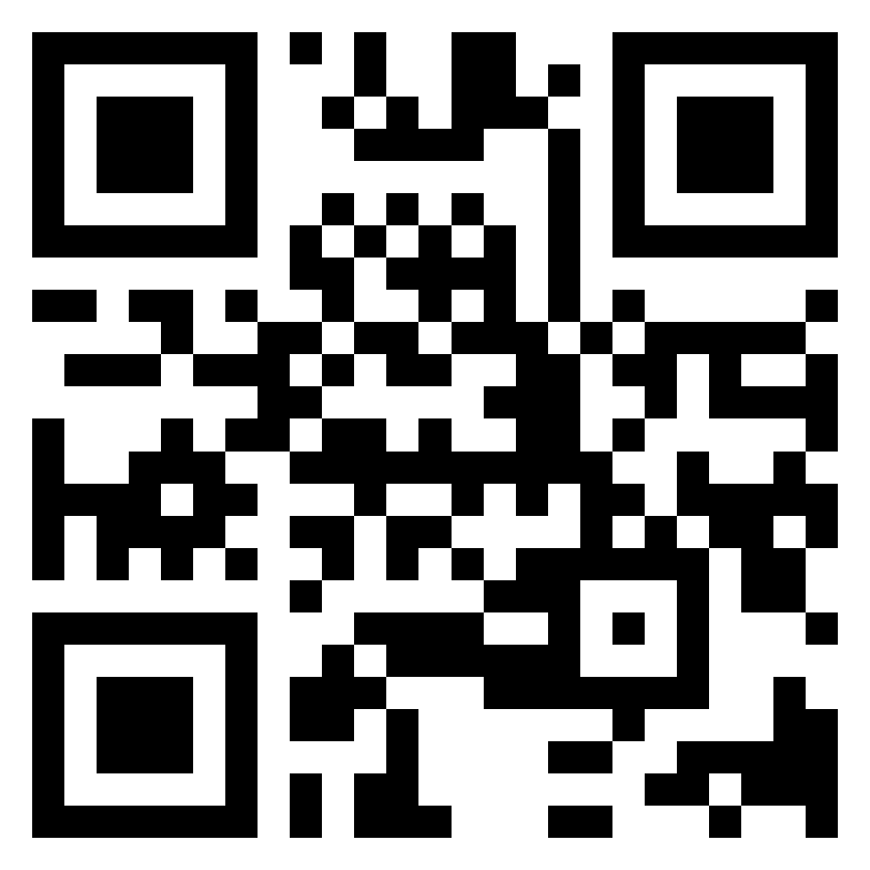

Scan to Join Nuclear Matters!
Text CARBONFREE to
+1 (202) 914-5764
OR

