Slide 1
Electric Industry State Update
USGO Conference – New Orleans
July 17, 2023

Slide 2




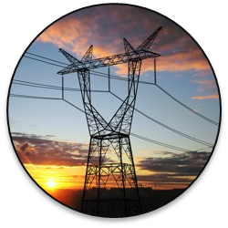


2023 Industry Priorities
Clean Energy & ESG
Resilience & Grid Security
Storm Response
& Wildfire Mitigation
Siting & Permitting
Reform
DEI & Workforce Development
Electric Transportation

Slide 3

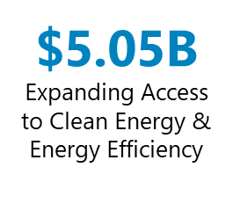


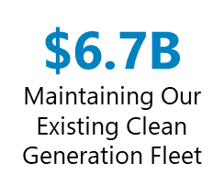
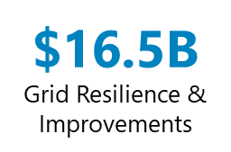



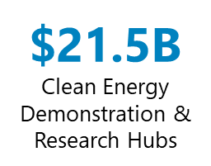
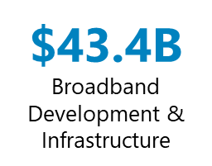
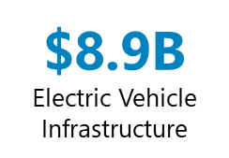
Bipartisan Infrastructure Law

Slide 4
Key State Regulatory & Legislative Policy Issues
Business Model Issues
Regulatory Compact
Electric Transportation
Transmission ROFR

Slide 5
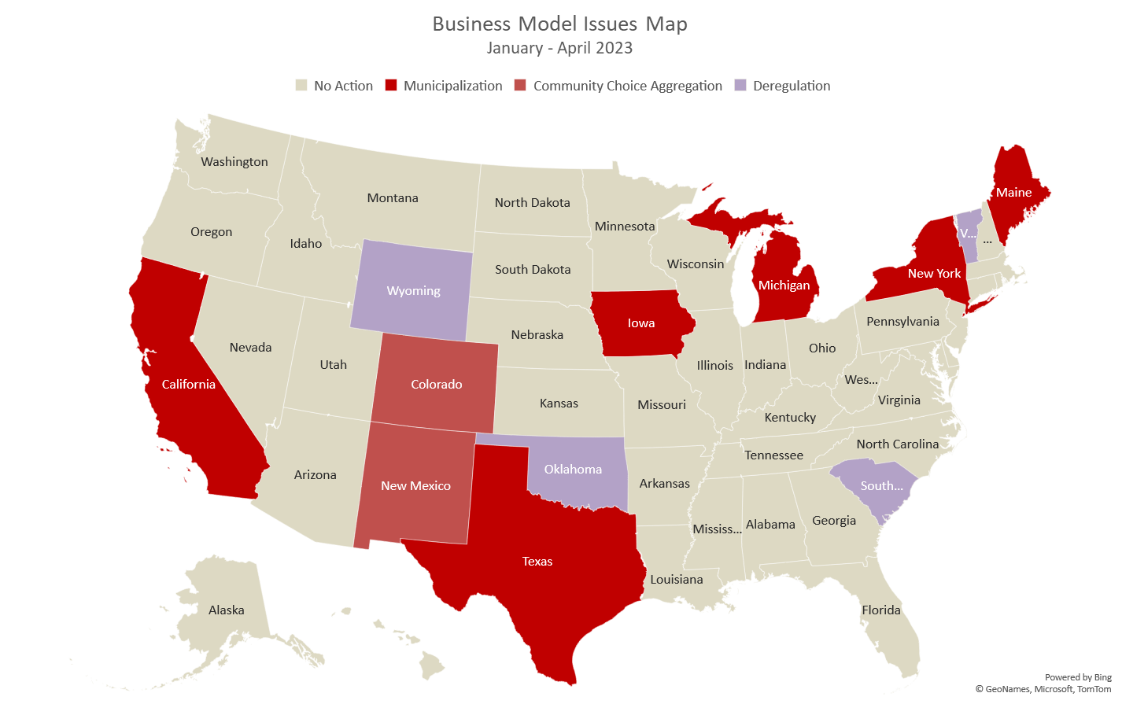
External Affairs Legislative Watchlist

Slide 6
Municipalization
Ballot initiatives to municipalize:
Maine – will be voted on in November
El Paso, TX – Prop K defeated in May
Decorah, IA – Under consideration
Notes:
Maine (entire state) – Our Power has been the driver for state-wide municipalization pushing to create a referendum on municipalization on the ballot. Our Power has been able to compile sufficient signatures to create a referendum for municipalization. Additionally, on the same ballot is a referendum that would require Maine voter approval of any new government debt over $1billion dollars. Both referendums are on the ballot and will be voted on this coming November.
In April, Maine’s highest court issued a ruling requiring the Secretary of State to reword the referendum question with a focus on revising the use of the term “quasi-governmental” in the ballot question.
El Paso, TX – Proposition K will be included on the ballot in a special election on May 6th proposing that the city adopt the El Paso Climate Charter pushing for more carbon free electricity and more aggressive net zero goals. Sunrise El Paso and Ground Game Texas are the primary drivers for this effort. On May 6th, a special election was held for Prop K and the measure was defeated with 40,680 votes in opposition and 9,190 in support.
Decorah, IA - . In January 2023, the City Council discussed whether or not to hold a second referendum. No agreement was reached however if two council members request the referendum the city will be required to add it as an agenda item to determine if an election should be scheduled on Sept. 12th to vote on municipalization.

Slide 7
Municipalization
Study the feasibility of municipalization:
New York (Long Island and Rochester)
California
Michigan
Notes:
Long Island, NY – Legislators called for the creation of a Legislative Commission to examine municipalization feasibility for Long Island Power Authority and discontinuing its operating contract with PSEG. Final report was due 4/1 with the commission implementing municipalization of LIPA by 12/31/2025. A draft report with recommendations was presented to the LIPA Legislative Commission, there has been no additional action at this time.
Rochester, NY – Members of the city council are calling on the state’s public service commission to investigate Rochester Gas & Electric (owned by Avangrid). In March, a letter was sent to the Commission condemning RG&E’s proposed rate increase and asking the Commission to fund a municipalization study.
San Diego, CA – In July 2021, the city had agreed to a 20-year franchise agreement with SDG&E, but the city included contract terms that allowed the city to use the franchise funds to be directed towards a public power research study. In Oct. 2022, the city used $3 million of those franchise dollars to help contract a new firm to study the possibility of municipalization. The first report of the new study is slated to be released in early 2023.
Ann Arbor, MI - In 2022, Ann Arbor City Council voted 10-1 approving a consultant and a contingency fund to complete a municipal electric utility feasibility study as an alternative to a full public power utility. The Council hired 5 Lakes Energy and Newgen Strategies & Solutions to complete the feasibility study.

Slide 8
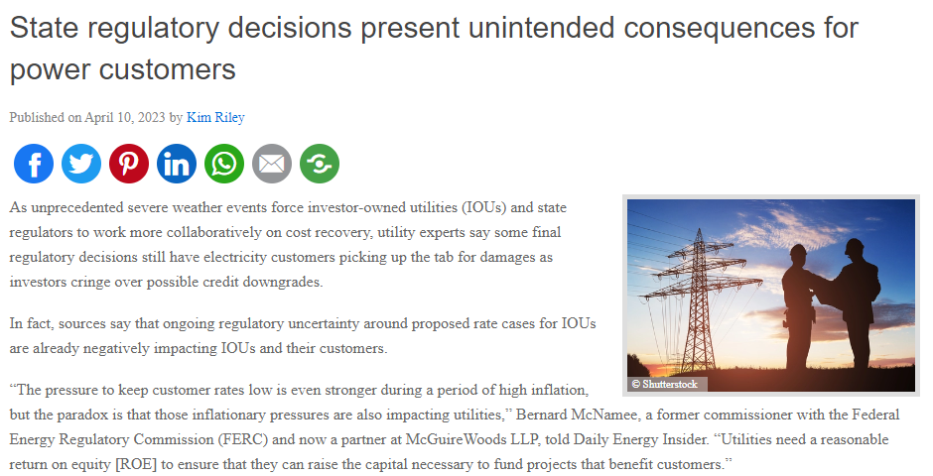
Erosion of Regulatory Compact
Notes:
https://dailyenergyinsider.com/featured/39205-state-regulatory-decisions-present-unintended-consequences-for-power-customers/

Slide 9
Erosion of Regulatory Compact
Legislation limiting cost recovery and other utility actions:
CO (enacted): inability to recover costs for fines, advertising, membership dues, and BOD compensation
CT (signed): PURA must consider “broad economic factors,” discourages settlements, precludes recovery of certain costs
KY (enacted): gives the PSC authority to approve or deny retirement of fossil generation
Notes:
Colorado and Connecticut have both introduced bills establishing limitations on cost recovery in rate cases.
The bill in Colorado, which was recently enacted, directs the Public Utilities Commission to establish rules to limit the amount of rate case expenses that an investor-owned or gas utility may recover from the utility’s customers. Utilities cannot seek cost recovery from its customers to pay for: 1) tax penalties or fines; 2) certain advertising and public relations expenses; 3) certain organizational and membership dues; 4) lobbying intended to influence local, state, or federal law-making; 5) more than half of annual total compensation or expense reimbursement for its board of directors; and 6) other expenses as specified. The Commission must also adopt rules by January 1, 2025 that establish mechanisms to align investor-owned utilities’ financial incentives with the financial interests of its customers regarding incurred fuel costs and prompt the Commission to consider incentive mechanisms for utilities to improve the efficiency of its electricity production. By March 15, 2024, the Commission must examine whether existing investor-owned electric utility tariffs, policies, and practices pose a barrier to the beneficial electrification of buildings and transportation, as well as the deployment of distributed energy resources.
The Connecticut legislature recently introduced a bill requiring the investigation of the procurement of standard service electricity and the regulation of public utilities as well as a provision to prohibit the cost recovery of all 501(c)(6) trade association dues. The bill includes provisions that would 1) require the Public Utilities Regulatory Authority to study standard service procurement, (2) prohibit recovery by public utilities of certain costs in rates, (3) amend ratemaking procedures and rate case regulations, including by placing limits on the use of settlements and requiring utilities to fund certain stakeholder groups' participation in rate cases, (4) regulate the compensation of executives and officers at public utility companies or parent companies, (5) change accident reporting rules, (6) change the rules applicable to utility outages, and (7) appropriate additional funding for the Authority. We are closely monitoring the CT bill and working in coordination with our members in the state.
In Kentucky, a bill was enacted giving the Public Service Commission rulemaking authority to approve or deny the retirement of utility-owned fossil fuel generating energy facilities in the state. The bill continues to specify the terms and conditions for facility retirement, limitations applied by the Commission for facility retirement approvals, and additional evidentiary requirements to be reported to the Legislative Research Commission. We are working with your members in Kentucky, as well as our state stakeholders in the governor’s office to continue to educate and provide awareness of the harm that this law may have on ratepayers in the long term.

Slide 10
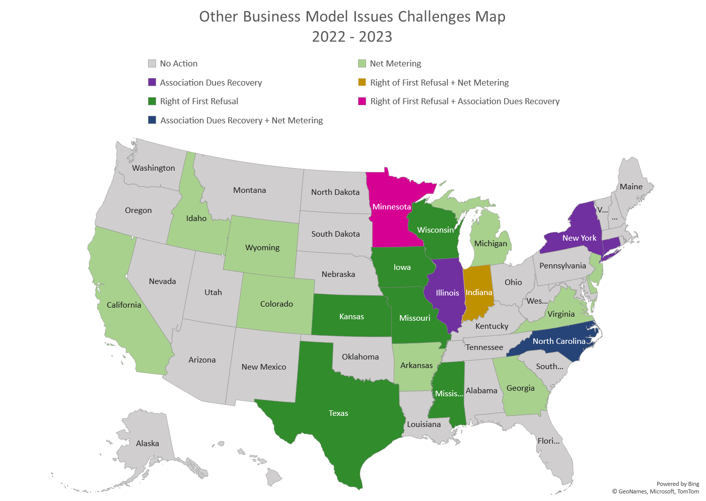
External Affairs Legislative Watchlist

Slide 11
Electric Vehicles
As of March 2023,
62 electric companies in 35 states and D.C., have received approval
Approved filings totaled $4.2 billion, an increase of $512 million since July 2022
Approved EEI Member Company EV-Related Regulatory Filings

Slide 12
Electric Vehicles
Groups wanting to restrict utility ownership of EV charging stations
Charge Ahead Partnership legislative push in 10 states
  Legislation was enacted in 3 states: GA, TX, and OK
Americans for Affordable Clean Energy interventions in regulatory proceedings in GA, IL, MN, MS, NV, OH, SC, TX, and WI
Notes:
Charge Ahead Partnership: All of our members are committed to promoting a fair and competitive electric vehicle charging market. Charge Ahead Partnership is proud to include more than one hundred businesses, organizations, and industry stakeholders from across the country. Members mostly consist of fueling and truck stop organizations
Americans for Affordable Clean Energy is a non-profit organization, organized pursuant to the Internal Revenue Code, Section 501(c)(4), with members consisting of owners and operators of convenience stores, public travel facilities and truck stops that provide goods and services to the traveling public at locations throughout Georgia and across the United States, primarily consisting of retail consumer goods, vehicle repair and service products, food, and fuel.

Slide 13
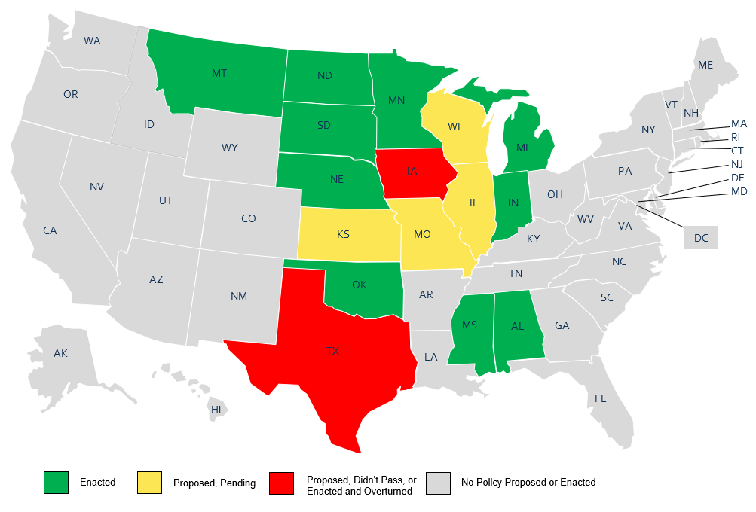
Right of First Refusal
Notes:
Right of First Refusal legislative provisions are also being discussed and challenged in a number of states. ROFR refers to incumbent utilities’ exclusive right to build, maintain, and own transmission lines within their service territory. If the incumbent utility declines, the transmission project is subject to competition.
Most recently Illinois introduced a bill to grant incumbent electric transmission owners the right to construct, own, and maintain proposed transmission lines that 1) connect to their existing transmission facilities, 2) have been approved for construction in a transmission plan, and 3) are or will be under the functional control of MISO.
Iowa
Enacted, challenged in court, temporary injunction placed on law
In June 2020, Iowa enacted H.F. 2643, codified as Iowa Code §478.16, reinstating the right of first refusal for incumbent electric transmission owners: “An incumbent electric transmission owner has the right to construct, own, and maintain an electric transmission line that has been approved for construction in a federally registered planning authority transmission plan and which connects to an electric transmission facility owned by the incumbent electric transmission owner. Where a proposed electric transmission line would connect to electric transmission facilities owned by two or more incumbent electric transmission owners, each incumbent electric transmission owner whose facility connects to the electric transmission line has the right to construct, own, and maintain the electric transmission line individually and equally. If an incumbent electric transmission owner declines to construct, own, and maintain its portion of an electric transmission line that would connect to electric transmission facilities owned by two or more incumbent electric transmission owners, then the other incumbent electric transmission owner or owners that own an electric transmission facility to which the electric transmission line connects has the right to construct, own, and maintain the electric transmission line individually.”
In October 2020, LS Power Midcontinent, LLC and Southwest Transmission, LLC filed a petition with the Iowa District Court seeking a temporary injunction on the effectiveness of Iowa’s state ROFR provision under Case No. 21-0696. In November 2020, MidAmerican Energy Company filed an application to intervene which was granted by the court in January 2021. The Iowa Utilities Board and other defendants filed a motion to dismiss, which the District Court granted in March 2021, ruling that plaintiffs did not have standing. Plaintiffs’ requests for reconsideration were denied in April 2021 and a notice of appeal was filed in May 2021. Plaintiffs requested a temporary injunction, which was denied by the Appeals Court in July 2022, again ruling the plaintiffs do not have standing. In March 2023, the Iowa Supreme Court issued an opinion vacating the District Court’s ruling and remanding the case back to the District Court to be decided on its merits. The Supreme Court also placed a temporary injunction on Iowa’s ROFR law, pending resolution of the case.
Minnesota
Enacted, challenged in court, upheld
Enacted April 2012 as SF1815, Minn. Stat. § 216B.246, subdiv. 2 establishes a state ROFR: “An incumbent electric transmission owner has the right to construct, own, and maintain an electric transmission line that has been approved for construction in a federally registered planning authority transmission plan and connects to facilities owned by that incumbent electric transmission owner.” Rights for transmission lines connecting facilities owned by more than one owner belong individually and proportionally to each incumbent electric transmission owner, unless otherwise agreed upon in writing.
In 2017, LSP Transmission Holdings, LLC filed suit in federal court against the Minnesota PUC, Attorney General, and Department of Commerce challenging the constitutionality of Minnesota’s ROFR. Specifically, LSP argued that the ROFR violates the dormant Commerce Clause, which forbids states from discriminating against or unduly burdening interstate commerce, even when no federal statute regulates the activity. Northern States Power Company and ITC Midwest intervened in the case on the side of the defendants. All defendants filed motions to dismiss the case.
On January 21, 2018, the U.S. District Court for the District of Minnesota granted the defendants’ motions to dismiss LSP’s lawsuit, holding that Minnesota’s interest in state regulation of electricity outweighs any ancillary impact on interstate commerce. LSP appealed to the U.S. Eighth Circuit Court of Appeals. On March 25, 2020, the court affirmed the lower court’s decision. The court concluded that the Minnesota ROFR was neither discriminatory on its face, in purpose, or effect; it also ruled that the ROFR did not result in an undue burden on interstate commerce.
In November 2020, LSP Transmission petitioned the U.S. Supreme Court to review its appeal. NSP-Minnesota filed a brief in opposition to this petition on Jan. 25, 2021. The Supreme Court denied LSP Transmission’s petition for a writ of certiorari in March 2021.
Introduced February 2023, SF 1456 would repeal Minnesota’s right of first refusal law. As of March 2023, the state Senate has not acted on the bill.
Wisconsin
Proposed, not enacted, will be reintroduced later in 2023
Proposed in January 2022 but did not pass – AB892/SB838 would have granted incumbent transmission facility owners the right to construct, own, and maintain transmission facilities that have been approved for construction in the MISO transmission plan and that connect to transmission facilities they own.
States that do not have ROFR rules but have restrictive definitions that make it difficult for non-incumbents:
• Arkansas
• Illinois
• Kentucky
• Virginia
• Delaware
• Louisiana

Slide 14
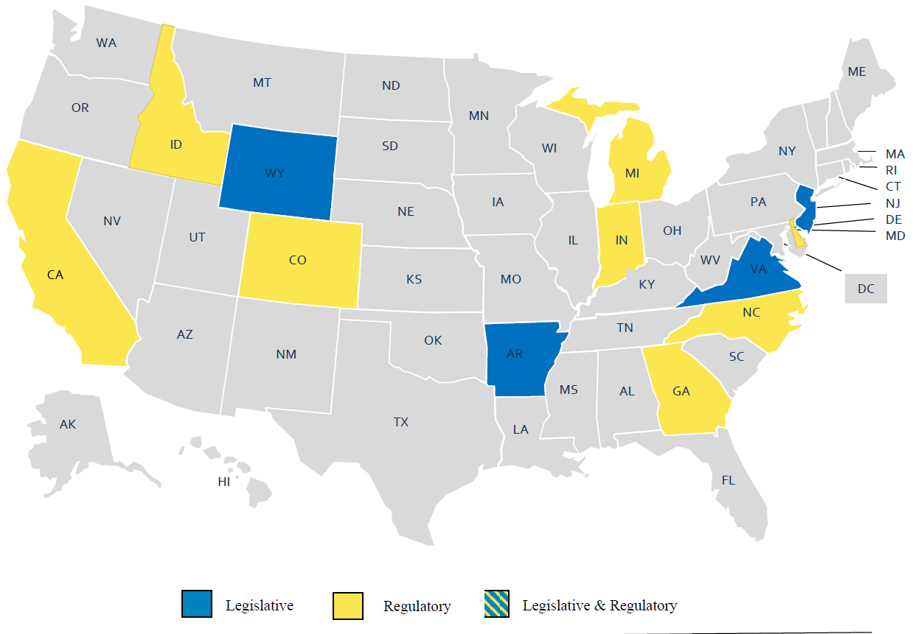
Net Metering
Most common actions:
  Changes to capacity limits
  Excess compensation
Notes:
Arkansas (Leg): lawmakers enacted legislation in March 2023 making significant changes to the state’s net metering policy. The changes will move the state to a net billing compensation structure, with electricity exported to the grid credited at the avoided cost rate. The legislation also authorizes monthly grid charges and adjusts system capacity limits, while grandfathering existing net metering customers under current rules until June 2040.
Indiana (Reg) – Docket No. 45504: In July 2022, the Indiana Office of Consumer Counselor, Citizens Action Coalition of Indiana, and Solar United Neighbors filed a motion to stay the appeal proceeding until Indiana Supreme Court case is decided as that ruling is expected to be relevant to this case. The Indiana Supreme Court upheld the Indiana Utility Regulatory Commission’s approval of Centerpoint Energy’s tariff filing, which included instantaneous netting.
Michigan (Reg) – Case No. U-21224: On April 28, 2022, Consumers Energy proposed changes to its Distribution Generation Program including aligning outflow compensation with locational-based market prices, offering an annual capacity payment for outflow supply, establishing a $20 minimum monthly bill, and voluntarily doubling the capacity of the DG program from 2% to 4% in the event the proposed DG changes are adopted. On December 22, 2022, Consumers Energy and other parties filed a joint settlement agreement that agreed to double the capacity of the DG program from 2% to 4% and included a DG outflow credit based on power supply rates including transmission costs. The commission approved the settlement agreement January 19, 2023.
New Jersey (Leg) – S.B. 2428: S.B. 2848 would establish a remote net metering program for public entities. Eligible solar projects for the program would have at least 10 participating public entity utility accounts as customers, be located within the same utility's service territory, and be less than 4 MW in total capacity. A public entity may agree to a hosting agreement for a solar energy project not located on public entity-controlled property (i.e. on private property) and receive a $10,000 per MW annual host fee from the owner of the project. The senate passed this bill with changes that increased the total capacity from 4 MW to 10 MW and removed the $10,000 per MW hosting fee provision but the bill did not pass the House.

Slide 15
Recent Rate Case Activity
14 decided electric rate cases in first half of 2023
  Average authorized ROE of 9.64%
  Approved rate increase of just over $900 million
28 electric rate cases filed in first half of 2023
  Average requested ROE of 10.39%
  Seeking almost $10 billion in revenue increase
Notes:
The decline in authorized ROEs has coincided with an upswing in rate case activity, with 100 or more cases adjudicated in 10 of the last 12 calendar years. This count includes electric and gas cases where no ROEs were specified, but it does not include withdrawn cases. At over 150 cases, rate case activity in 2021 was the most robust observed in any year during the 1990-2022 period. In 2022, 136 cases were decided.

Slide 16
Recent Rate Case Activity
Alternative Regulation Proposals
  Multi-year Rate Plans: 7 states and DC
  Adjustment Mechanisms: inflation (NY), production and investment tax credits due to IRA (MO), and distribution capital expenditures for demand response, EV integration and reliability and resilience (MI)
Notes:
Exelon Corp. subsidiary Baltimore Gas and Electric Co. is seeking PSC approval of new multiyear electric and gas rate plans to take effect, following the expiration of existing rate plans at the end of 2023. The company seeks a 10.40% ROE that would be in place for gas and electric operations for all three years of the plan. A new multiyear rate plan, seeking to phase in a $213.6 million cumulative rate increase, was also filed by Exelon Corp. subsidiary Potomac Electric Power Co. (Pepco). The company seeks a 10.50% ROE, almost 100 basis points above that approved under the utility’s current multiyear plan that is in place through March 31, 2024. The new plan, if approved by the PSC, would begin when the current multiyear plan expires. Pepco said inflation, coupled with the concomitant upward movement in interest rates, suggests that long-term capital costs, including the cost of equity, have increased significantly since its previous rate proceeding.
Pepco also has a multiyear rate plan request pending before the District of Columbia. The company is seeking a 10.50% ROE in that case.
The United Illuminating Co. (UI) is seeking to operate in Connecticut under a three-year electric distribution rate plan, effective from Sept. 1, 2023, through Aug. 31, 2026. UI’s upcoming rate case will be the first to be adjudicated under a law enacted in 2020. The law increased the amount of time the Connecticut Public Utilities Regulatory Authority (PURA) must render a decision in an energy rate case to 350 days from 150 days. The PURA has not issued an energy rate decision since 2018. A recent disappointing, albeit nonunanimous, rate case decision issued by the PURA for Eversource Energy subsidiary Aquarion Water Co. of Connecticut Inc. gave rise to incremental uncertainty surrounding the overall tenor of regulatory policy in the state and could have negative implications for energy investor-owned utilities in the state. In that decision, the PURA authorized the company an 8.70% ROE, the lowest nonpunitive return authorized for a water utility since 2010, as tracked by RRA. UI is a subsidiary of Avangrid Inc. Iberdrola SA is the parent company of Avangrid.
In Idaho, Avista Corp. is seeking approval for a two-year electric and gas rate plan. Avista is seeking a 10.25% ROE, which it deems “reasonable when considering capital market expectations, capital expenditure funding pressures, the company’s exposure to energy market volatility and potential risks that may arise throughout its two-year rate plan.”
NiSource Inc. subsidiary Northern Indiana Public Service Co. (NIPSCO) reached a settlement in its pending rate case that, if approved by the Indiana Utility Regulatory Commission, would provide for a $261.9 million two-step base rate increase premised upon a 9.80% ROE. The rate change would be implemented in at least two steps. The first-step rate change would take effect shortly after the commission issues an order in the case and would be subject to refund pending verification of the company’s “certified” rate base, depreciation expense and capital structure balances as of June 30. The second-step rate increase would be implemented March 1, 2024, and would also be subject to refund pending verification of the company’s certified balances as of Dec. 31, 2023.
In pending electric, gas and steam rate cases in New York, CECONY is seeking to operate under multiyear rate plans. A settlement was reached in February, calling for the adoption of three-year electric and gas rate plans covering the period from Jan. 1, 2023, through Dec. 31, 2025. If approved by the New York Public Service Commission, the settlement would provide for $1.342 billion electric and $512.5 million gas total base rate increases premised upon a 9.25% ROE. The company would be subject to earnings sharing with customers when its earned ROE exceeds a 9.75% ROE threshold.
With inflation soaring, several utilities in their pending rate cases are seeking specific mechanisms to address these inflationary pressures. CECONY seeks an inflation reconciliation mechanism in its steam case. The utility had sought a similar mechanism in its electric and gas cases, but the settlement reached in the case does not call for one.
NYSEG and RG&E are also seeking to implement reconciliations for inflation. NYSEG and RG&E said inflation is causing atypical upward cost pressures. The utilities said they “are experiencing macro-economic pressures including higher rates of inflation, higher interest rates and restrictions in supply that have substantially increased costs beyond the companies’ control for essential business items like labor, benefits, materials and contractor costs.” The New York PSC had previously approved an inflation reconciliation adjustment for the companies as part of a multiyear rate case settlement adopted in 2010.
Duke Energy Corp. subsidiary Duke Energy Kentucky Inc., in its recently filed rate case, is seeking to implement several cost recovery mechanisms that would facilitate the recovery of certain unrecovered plant costs upon retirement and costs municipalities imposed upon the company.
A settlement reached in Ameren Corp. subsidiary Union Electric Co.’s pending rate case before the Missouri Public Service Commission calls for a tracking mechanism to account for certain production tax credits and investment tax credits resulting from the Inflation Reduction Act of 2022.
In its pending case before the Michigan Public Service Commission, DTE Energy Co. subsidiary DTE Electric Co. is seeking an investment recovery mechanism, which is focused on certain distribution capital expenditures addressing customer safety, customer reliability and the integration of increasing levels of EVs and distributed energy resources that it will recover through this mechanism surcharge.
In another pending case in Michigan, Consumers Energy Co. is seeking a distribution investment recovery mechanism that reinforces the company’s commitment to distribution system reliability and resiliency and an all-encompassing demand response surcharge to separate demand response-related costs from the overall base rate revenue requirement. Consumers Energy is a CMS Energy Corp. subsidiary.
In UI’s pending multiyear rate request, the utility is seeking to implement a symmetrical ROE adjustment mechanism that would adjust the ROE in each year of the plan beginning in year two to reflect market conditions. According to company testimony, “a multi-year rate plan, which eliminates the possibility of adjusting costs over several years, increases the overall risk profile of the company. This is exacerbated in the current market conditions, where inflation has been unrelenting, interest rates are increasing and market conditions have been volatile.”

Slide 17
Recent Regulatory Activity
CA Income Graduated Fixed Charge Proceeding
Statutorily required by AB 205 (2022)
Removes requirement that costs must be recovered by volumetric rates
Instead, requires most costs to be recovered via a fixed charged based on customer income
Party | Proposed Income Graduated Fixed Charge Amounts
Utilities | $15 - $128
CalAdvocates | $27 - $35
SEIA | $4.93 - $13.14
NRDC and TURN | $5 - $76
Notes:
Docket No. R2207005
In mid-2022, the California legislature, through Assembly Bill (AB) 205, removed the statutory language requiring default residential rates to be almost exclusively charged on a volumetric basis and provided a framework to make the residential electricity rate structure more equitable. That bill’s amendments to Public Utilities Code § 739.9 now allow the CPUC to take the next step in needed residential electric rate reforms, by collecting through a set IGFC costs that do not vary volumetrically or are more equitability collected in a fixed charge. AB 205 aims to offer all customers better price signals while also providing additional affordability protections for low-income customers through the IGFC. The CPUC must adopt a new electric rate structure no later than July 1, 2024.
On July 14, 2022, the CPUC issued an order instituting a rulemaking to enable widespread demand flexibility through electric rates. The Commission will establish demand flexibility policies and modify electric rates to advance the following objectives: (a) enhance the reliability of California’s electric system; (b) make electric bills more affordable and equitable; (c) reduce the curtailment of renewable energy and greenhouse gas emissions associated with meeting the state’s future system load; (d) enable widespread electrification of buildings and transportation to meet the state’s climate goals; (e) reduce long-term system costs through more efficient pricing of electricity; and (f) enable participation in demand flexibility by both bundled and unbundled customers.
The Commission issued a proposed decision on 10 rate design principles, on March 17, 2023. The information below summarizes major stakeholder initial testimony filed in early April 2023.

Slide 18


