Slide 1
Utilities State Government Organization 2023 Annual Meeting
Matt Kiessling
Senior Director, State Affairs

Slide 2
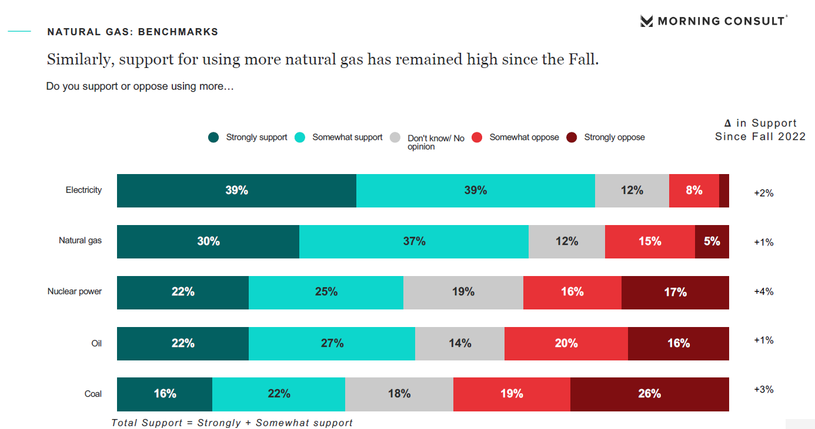
Gas Remains Favorable

Slide 3
Gas Remains Favorable

Slide 4
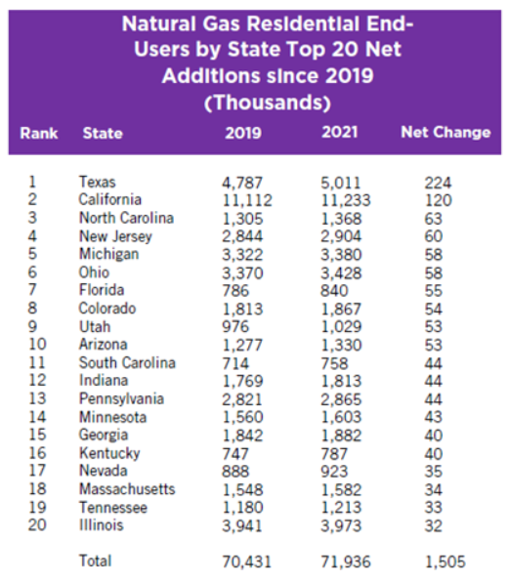
Growth Continues
Customers:
The number of residential natural gas consumers grew by 1.5 million between 2019 and 2021
There are 77.7 million natural gas customers in the US:
71.9 Residential Customers
5.6 Commercial Customers
82,000 Industrial
The industry continues to add more than a customer a minute for every minute of the year.

Slide 5
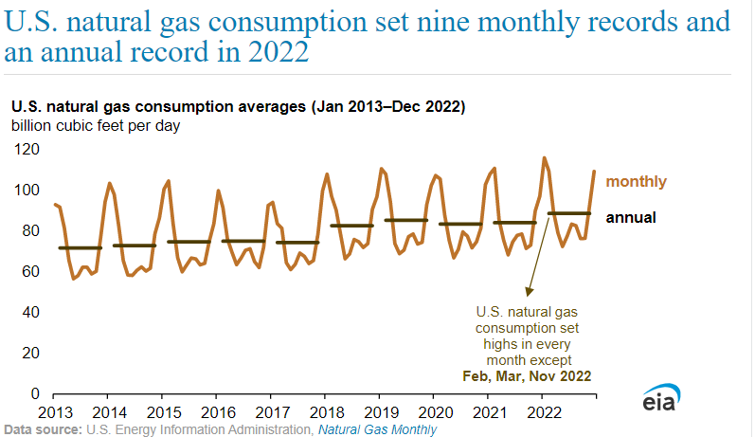
Growth Continues

Slide 6
State of Play

Slide 7
In the States: Energy Policy

Slide 8
State Challenges & Trends
Federal Money Flowing to States
Greater Scrutiny of Line Extension and Pipeline Replacement Programs
Increased Focus on Pre & Post Meter Emissions
Greater Scrutiny of Capital Investments
Increased Sophistication of Opposition Groups
Notes:
These trends present obstacles to traditional regulatory matters. Intervenors are seizing opportunities to address and scrutinize areas of gas utility operations. These issues may not be present in all jurisdictions; however, they are increasingly gaining attention nationwide.
Increased sophistication of opposition groups
Cite the “growth” of EDF and NRDC. Reference their papers from 3 years ago today. EDF is presenting a fairly complex acceleration depression argument
ACEEE’s Building Electrification: Programs and Best Practices report
RMI’s Overextended: It’s Time to Rethink Subsidized Gas Line Extensions report
Increased focus on pipeline programs
Line Extension Allowances (Number of proceedings where this issue was discussed either by the commission or intervenor)
Line extension programs are an essential driver for community and economic development. These programs, originally championed by regulators and developers due to their substantial impacts on bringing energy to underserved areas, are now being scrutinized and re-examined in regulatory proceedings. In the past year, we have tracked 6 states where line extension programs were scrutinized in regulatory proceedings.
The California Public Utilities Commission in a September 15 order outlined the elimination of natural gas utility line extension programs beginning June 1, 2023. Each gas utility may file for a yearly allowance for non-residential line extensions beginning July 1, 2023; however, the allowance will be subject to prudency and environmental impact review.
In the recent Corning Natural Gas rate case, it was ordered that Corning must consult with New York Public Service Commission staff on any line extension greater than 500 feet. Corning shall present alternatives to any proposed line extension greater than 500 feet, and it shall make potential customers aware of natural gas heating alternatives.
In Avista’s ongoing rate case, a settlement was filed by Avista that included reducing its allowance for line extensions to zero in 2025. The settlement is supported by all intervenors in the case. The case is currently pending a final order.
Pipe replacement programs (Number of proceedings where this issue was discussed either by the commission or intervenor)
The Maryland Consumer advocate just published a paper criticizing AGA members investments
Indoor Air Quality Claims are Rising (Number of proceedings where this issue was discussed either by the commission or intervenor). I will use SW Gas proceeding as an example
Prior to 2020, Indoor Air Quality filings in regulatory proceedings were almost a non-existent issue. Now, we are actively tracking a growing number of filings. We have tracked more than 10 filings relating to indoor air quality with that number growing by the month.
In the ongoing Colorado Clean Heat Proceeding, Conservation Advocates propose in Rule 4731(e)(I)(D) a number of new analyses and inputs for inclusion in utility cost-benefit analyses. Many of the analyses request, for example, impacts on indoor air quality and general health impacts that are wholly beyond the expertise of the Company and call for speculation. The matter is ongoing.
In the ongoing NW Natural rate case, a group of intervenors, the “Coalition”, cited NW Natural advertising campaign on gas cooking is adverse to the health of consumers and that NW natural demonstrated no specific ratepayer benefits from such advertising.
In the ongoing Vermont Gas proceeding seeking approval for out-of-state purchased of renewable gas, a witness submitted into the docket a report, “Effects of Residential Gas Appliances on Indoor and Outdoor Air Quality and Public Health in California”. The report attempts to link negative indoor air quality to the direct use of gas appliances. The proceeding is ongoing.
Greater Scrutiny of Association Dues (Number of proceedings where this issue was discussed either by the commission or intervenor)
The fact of the matter is this is brought up in every proceeding in some fashion. Where we are concerned is recent publications and proceedings relating to this issue, notable FERC Docket RM22-5-000, Rate Recovery, Reporting, and Accounting Treatment of Industry Association Dues and Certain Civic, Political, and Related Expenses
Earlier this year, New York had recently passed a law prohibiting rate recovery of “membership fees or dues associated with any organization engaged in lobbying efforts, regardless of whether such fees or dues are separate from ‘below the line’ lobbying costs versus ‘above the line’ costs for non lobbying activities.”
In the current Southwest Gas rate case, the Arizona Residential Utility Consumer Office (RUCO) challenged the inclusion of AGA dues in rate base on the basis of AGA’s lobbying and advocacy activities. The case is pending a final order.
In the recent Atmos Kentucky rate case, the Kentucky PSC ordered in May that all AGA dues filed for inclusion in base rates be disallowed. The order cited that Atmos had not met the burden of proof relating to AGA’s lobbying and advocacy activity, resulting in the disallowance.

Slide 9
Eugene, OR Ballot Initiative
Gas Ban initiative qualified for the Eugene Ballot:
November election
First time general public will get to vote on a gas ban
July 10, 2023: Eugene City Council repeals its own gas ban

Slide 10
El Paso , TX Prop K Ballot Initiative
Broad Climate Initiative
Prevent El Paso Water from selling water to fossil fuel industry operations outside the city limits
Municipalize the electric utility
Cost to implement: $154 Million

Slide 11
The Role of Natural Gas in Our Economy

Slide 12
Advancing America Series
AGA’s Advancing America series, examines how natural gas is critical to many sectors of the U.S. economy.
The series will provide hard data on how abundant, affordable natural gas is essential to four major industries.
Agriculture
Hotels & Hospitality
Healthcare (Hospitals, universities)
Pharmaceutical Manufacturing

Slide 13
Advancing America: Agriculture
Top Lines:
U.S. agriculture is a major part of the economy:
17.2 millions jobs
$1.75 trillion GDP
U.S. agriculture is one of the largest consumers of natural gas. When including direct use and use throughout the industrial supply chain, the U.S. agriculture sector consumes roughly 1,700 Bcf of natural gas – equivalent to almost 15% of all U.S. commercial and industrial consumption of natural gas.
Just five of the many subsectors within agriculture consumed 2.06 trillion cubic feet of natural gas in 2021, nearly equivalent to the total consumption of California, which is the second largest natural gas consuming state.

Slide 14
Advancing America: Hospitality
Top Lines:
The hospitality sector consumes nearly 300 billion cubic feet of natural gas each year, which is more than the natural gas consumption of Connecticut.
Mandated electrification would increase fuel costs by $9.8 billion across the sector over the next 25 years.
U.S. Hospitality is a major part of the economy:
13.5% of all U.S. jobs,
$1.8 trillion in GDP
$161 billion in state and local taxes
Without Natural Gas, U.S. hospitality sector’s gas use with electricity would increase consumer prices over $600 million per year. That is increase of more $500 year for a family of four.

Slide 15
The Future of Our Industry

Slide 16
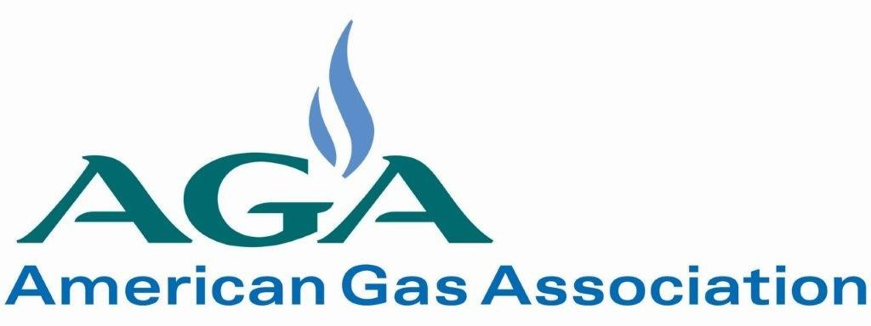
Renewable Natural Gas State Activity
65 Bills
28 Bills
State Legislative Proposals
have been introduced
have become law
18 Natural Gas Utilities
have begun developing
or have implemented
Voluntary Green Tariffs
Voluntary Programs
Activity in 37 states to promote the use of RNG in the residential or commercial sector through either legislative, regulatory, or utility led action.
25 Natural Gas Utilities
are engaged in RNG production projects
Utility Led RNG Projects
*this data does not include RNG interconnection activity
Notes:
RNG – Policy and Program Tracker – Variety of efforts underway across the country impacting RNG.
AGA has begun tracking this information for members in an easy to use reference.
We are focusing on RNG use in the commercial and residential sector – not the transportation market – and tracking any voluntary Gas utility programs, any state policies that have been introduce, laws that have been passed, and any regulatory efforts addressing RNG use to meet thermal load.
RNG interconnection and gas quality.
O&E has several technical committees addressing issues relevant to RNG gas quality and blending.
18 Utilities with or developing tariffs
1) SoCal 6) CenterPoint (MN)
2) SDG&E 7) National Grid (NY)
3) Summit (ME) 8) NW Natural (OR & WA)
4) DTE 9) Vermont Gas
5) Dominion (UT & NC) 10) Xcel
11) Puget Sound Energy 12) Nicor Gas
13) Piedmont Natural Gas (NC) 14) Liberty Utilities (NH & MA)
15) ONE Gas (OK)
16) Avista (WA, ID & OR)
17) NiSource (proposed in MD, & PA) – approved in VA & IN
18 Black Hills Energy (CO, NB, KS, AR, WY, & AR)
1) SW Gas
2) SoCal
3) TECO People’s Gas
4) Hawaii Gas 11) Vermont Gas
5) Summit 12) Puget Sound Energy
6) Liberty 13) DTE
7) National Grid 14) Chesapeake
8) Duke Energy 15) Unitil
9) Dominion 16) ONE Gas
10) NW Natural 17) Southern Gas Co
18) South Jersey Industries
19) UGI 20) WGL
21) Consumers Energy
22) Roanoke Gas
23) WEC
24) Black Hills Energy
25) PSEG

Slide 17
Hydrogen
Gas Utilities are innovating for the future:
The integration of clean hydrogen into gas systems can expand options and accelerate our nation’s ability to reduce emissions
There are more than 25 states or provinces where utilities are actively engaged in hydrogen research, testing or projects
16 major hydrogen projects have been proposed across 36 states to seek hydrogen hub funding

